Slide 1
World Systems Theory
Immanuel Wallerstein

Slide 2
Basic Tenets
The world economy has one market and a global division of labor
Although the world has multiple states, almost everything takes place within the context of the world economy
The world economy has a three-tiered structure

Slide 3
World Economy
Began with capitalist exchange circa 1450, global by 1900
Capitalism = world economy, people, corporations and states produce goods and exchange them on the world market with the goal of achieving profit
Profit = cheapest labor on the globe and commodifying

Slide 4
Commodification
Process of placing a price on a good and then buying, selling and trading the good
New products, new twists on old products, create demand through marketing (bottled water)
Economic independence is impossible – economies of the world are tied together (world economy since 1900)

Slide 5
Three-tiered Structure
Core – place and process
Incorporate higher levels of education, higher salaries, and more technology
Generate more wealth in world economy
Periphery – place and process
Incorporate lower levels of education, lower salaries, and less technology
Generate less wealth
Semi-periphery – places where other 2 processes occur
Exploited by the core, but turn and exploit the periphery
Prevents polarization of world into two extremes

Slide 6
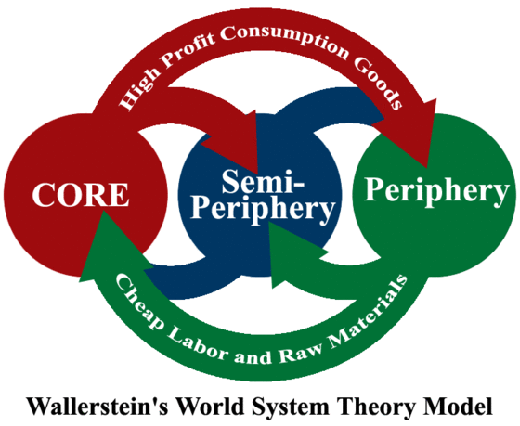
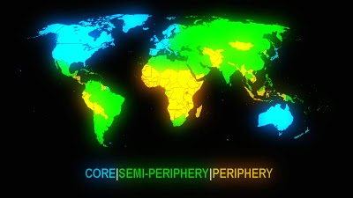

Slide 7
World System and Political Power
Economic power means wealth
Political power means ability to influence others to achieve your goals
Not the same as sovereignty
Wealth helps amass political power
Political power can be diplomatic (Switzerland’s neutrality and economic might aid diplomatic efforts)
Post colonial Africa and Asia are working to build nation-states to unite people, secure territory and develop economic systems

