Slide 1
How Has Terrorism Increased?

Slide 2
OBJECTIVES
Terrorism by Individuals and Organizations
State Support for Terrorism

Slide 3
What is Terrorism?
The systematic use of violence by a group in order to intimidate a population or coerce a government into granting its demands.
Through bombing, kidnapping, hijacking, taking of hostages, indiscriminate killings, and assassinations.

Slide 4
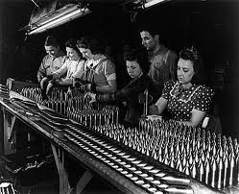
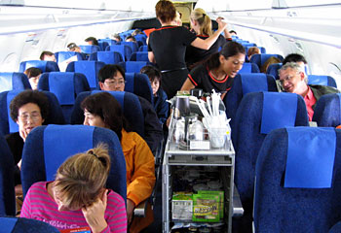
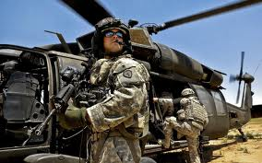
WHAT DO ALL THESE PEOPLE HAVE IN COMMON?

Slide 5
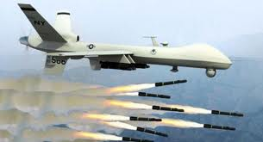
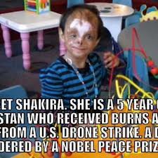
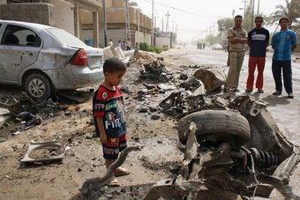
Terrorism by Individuals and Organizations
Civilians are legitimate targets because they cooperate/ and are citizens of a particular state.
States argue they are not terrorist despite the collateral damage (unintentional targets)

Slide 6
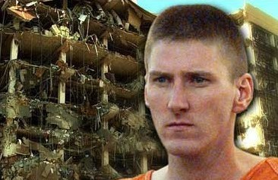
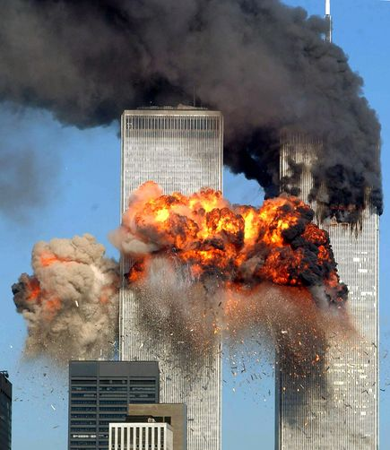
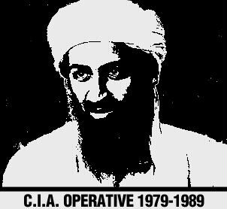
Terrorism Against Americans
Several terrorist attacks in the late 20th Century.
Al Qaeda network founded by Osama Bin Laden/ Jihadist
1996 Fatwa (decree) to wage war against US for Iraq Invasion, support of Israel, and military presence in Saudi
September 11, 2001 deadliest attack
Dozens of other attacks: Egypt, Turkey, England, Spain, Indonesia, Kenya, Jordan
2011: Bin Laden killed in Pakistan. Al Qaeda continues
Notes:
Pan Am, 1st World Trade, Oklahoma City, US Embassy Kenya/ Tanzania, Bombing USS Cole

Slide 7
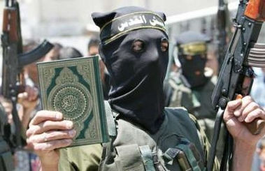
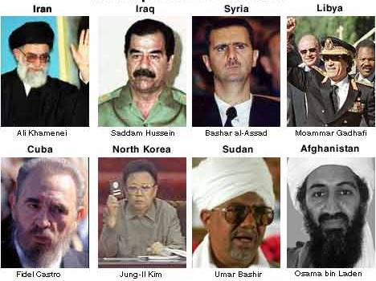
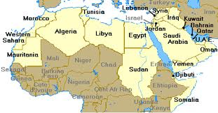
State Support for Terrorism
Providing sanctuary for terrorists wanted by other countries.
Supplying weapons, money, and intelligence to terrorists.
Planning attacks using terrorists.
Jihadist versus Pan-Arab nationalist
Libya, Afghanistan, Iraq, Egypt, Iran, Pakistan
Notes:
Qaddafi, Taliban, Saddam/ Ba’ath kuwait invasion, Muslim Brotherhood opposition to dictator mubarrak, Shah 1979 vs Ayatollah, sanctuary to tribal groups opposed to US.

Slide 8
Can the Usa be considered a state sponsor of terrorism?

Slide 9
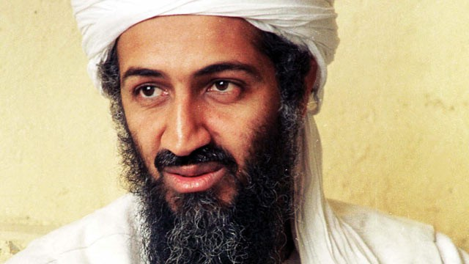
W.W.OBL.D?
Bin Laden allegedly quoted the following passage: "If I were president, I could stop terrorist attacks against the United States in a few days. Permanently. I would first apologize - very publicly and sincerely - to all the widows and orphans, the impoverished and the tortured, and the many millions of other victims of American imperialism. Then I would announce to every corner of the world that America's global military interventions have come to an end."

Slide 10
WHAT DO THEY/YOU SEE?
US: Through bombing, kidnapping, hijacking, taking of hostages, indiscriminate killings, and/ or assassinations.
THEM: Financial/ Military support for opposition groups, Special Forces, invasion, War, Occupation, Collateral Damage, Torture, Execution

Slide 11
1949 - Kim Koo, Korean opposition leader 1950s - CIA/Neo-Nazi hit list of more than 200 political figures in West Germany to be "put out of the way" in the event of a Soviet invasion 1950s - Zhou Enlai, Prime minister of China, several attempts on his life 1950s, 1963 - Sukarno, President of Indonesia 1951 - Kim Il Sung, Premier of North Korea 1950s (mid) - Claro M. Recto, Philippines opposition leader 1955 - Jawaharlal Nehru, Prime Minister of India 1957 - Gamal Abdul Nasser, President of Egypt 1959 - Norodom Sihanouk, leader of Cambodia 1960 - Brig. Gen. Abdul Karim Kassem, leader of Iraq 1950-70s - Jose Figueres, President of Costa Rica, two attempts on his life 1961 - Francois "Papa Doc" Duvalier, leader of Haiti 1961 - Patrice Lumumba, Prime Minister of the Congo 1961 - Gen. Rafael Trujillo, leader of Dominican Republic
1963 - Ngo Dinh Diem, President of South Vietnam 1960s - Fidel Castro, President of Cuba, many attempts and plots on his life
1960s - Raul Castro, high official in government of Cuba
1965 - Francisco Caamano, Dominican Republic opposition leader 1965-6 - Charles de Gaulle, President of France 1967 - Che Guevara, Cuban leader 1970-1973 - Salvador Allende, President of Chile 1970 - Gen. Rene Schneider, Commander-in-Chief of Army, Chile 1970s, 1981 - General Omar Torrijos, leader of Panama 1972 - General Manuel Noriega, Chief of Panama Intelligence 1975 - Mobutu Sese Seko, President of Zaire 1976 - Michael Manley, Prime Minister of Jamaica 1980-1986 - Moammar Qaddafi, leader of Libya, several plots and attempts upon his life. Killed 2010 1982 - Ayatollah Khomeini, leader of Iran 1983 - Gen. Ahmed Dlimi, Moroccan Army commander 1983 - Miguel d'Escoto, Foreign Minister of Nicaragua 1984 - The nine comandantes of the Sandinista National Directorate,
Nicaragua 1985 - Sheikh Mohammed Hussein Fadlallah, Lebanese Shiite leader 1991-2000 - Saddam Hussein, leader of Iraq (2004 killed) 1998-2000 - Osama bin Laden, leading Islamic militant 1999-2000 - Slobodan Milosevic, President of Yugoslavia

Slide 12
What is Terrorism?
The systematic use of violence by a group in order to intimidate a population or coerce a government into granting its demands.
Through bombing, kidnapping, hijacking, taking of hostages, indiscriminate killings, and assassinations.

