Slide 1
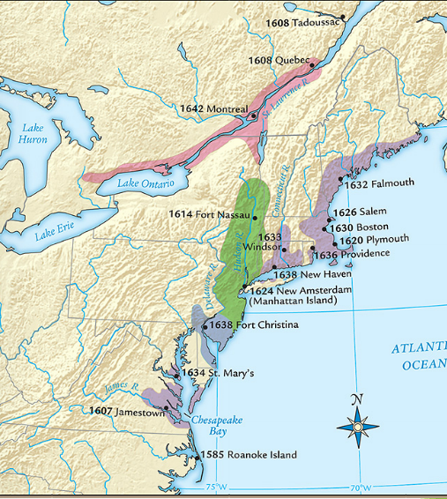
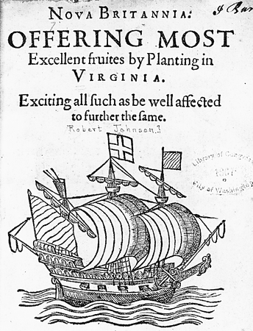
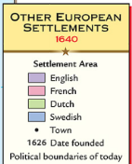
In 1607, settlers founded Jamestown the first permanent British colony in America along the Chesapeake Bay in present-day Virginia
Quick discussion: How did the settlers gain rights and money to create a colony?
Jamestown was founded by British entrepreneurs of a joint-stock company called the Virginia Company
In 1606, Virginia Company investors gained a charter from the king, recruited settlers, and sent them to America in search of gold

Slide 2
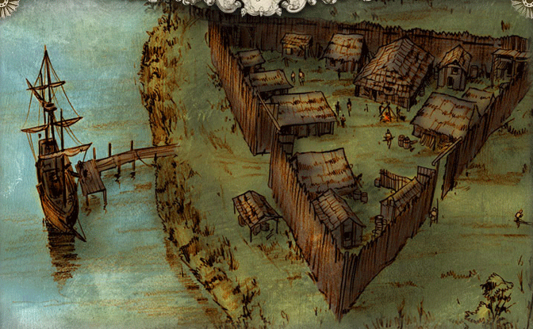
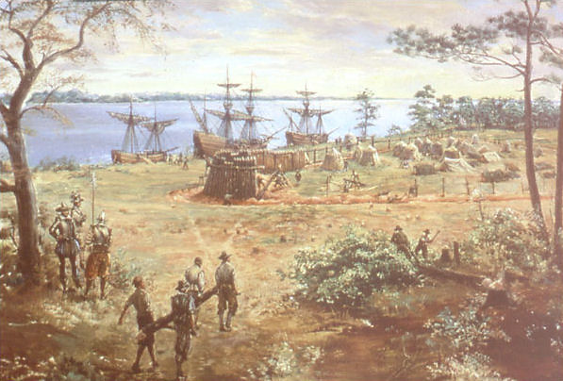
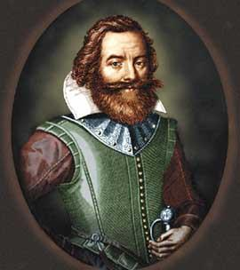
Settlers built a fort, but struggled to survive in their first years in America
Settlers arrived looking for gold so they did not prepare to stay long in America; They did not plant crops & faced starvation
John Smith took control & forced settlers to farm
“He who will not work, will not eat”
Notes:
Clash of cultures; settlers had no experience in founding a settlement-they simply did what they knew. This did not work

Slide 3
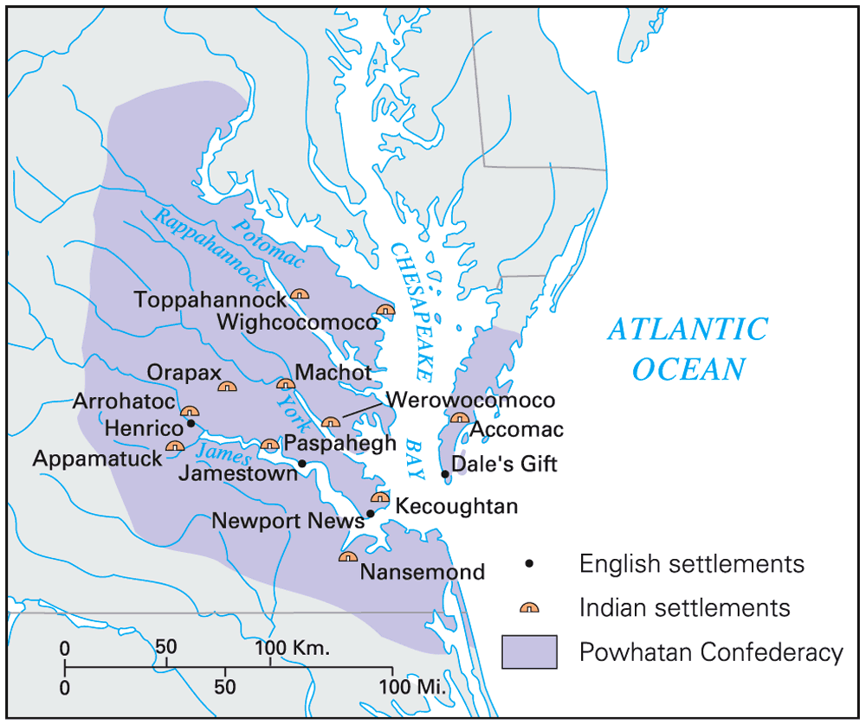
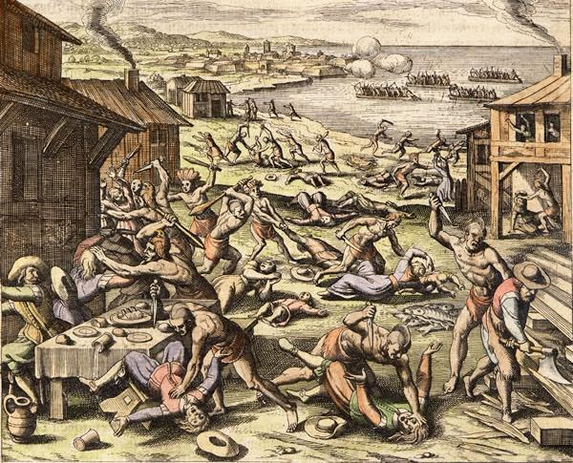
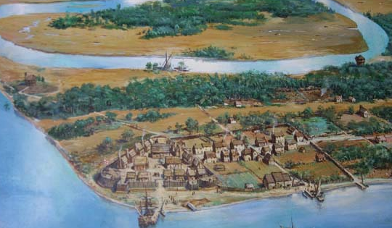
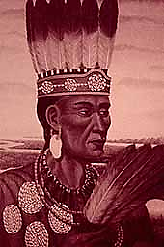
Jamestown was located on a swamp & led to outbreaks of disease among colonists
Jamestown was located in territory controlled by the Powhatan Indians who attacked the settlement
Notes:
The 1622 Powhatan uprising killed 347 Jamestown colonists

Slide 4
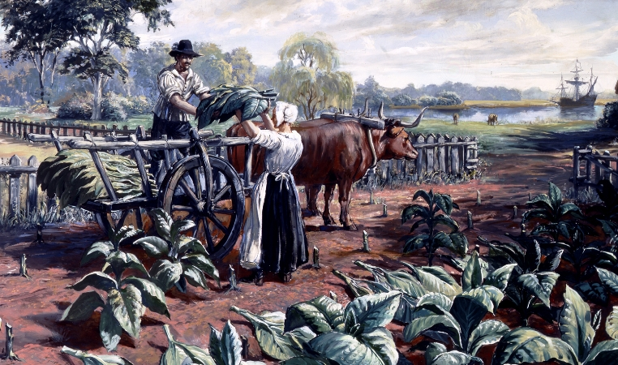
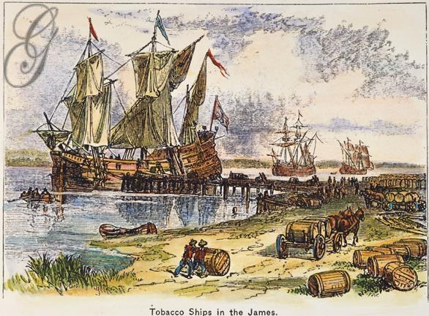
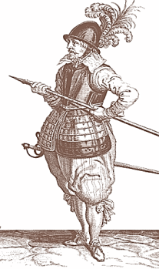
After the Jamestown colonists failed to find gold, the joint-stock investors demanded that colonists find a way to make money
In 1612, John Rolfe introduced tobacco in Jamestown which was popular in Europe & made investors money
Notes:
explain Virginia's development including the Virginia Company, tobacco cultivation, relationships with Native Americans such as Powhatan, development of the House of Burgesses, Bacon's Rebellion, and the origins of American slavery

Slide 5
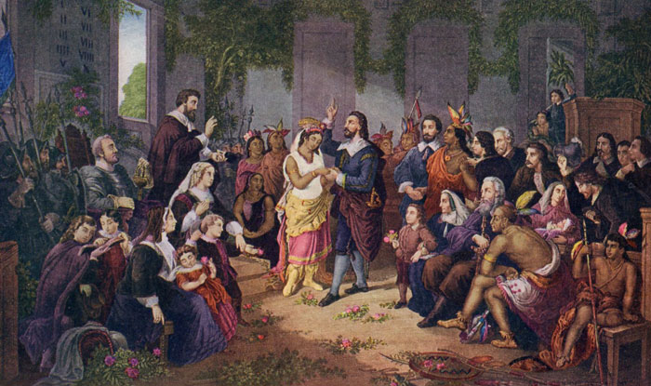
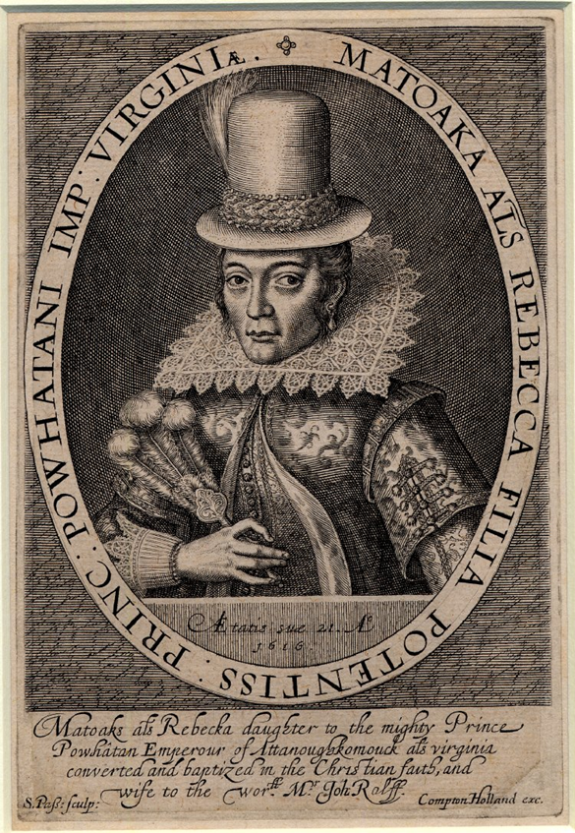

Slide 6
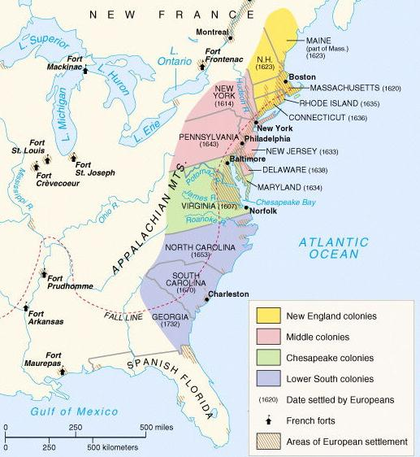
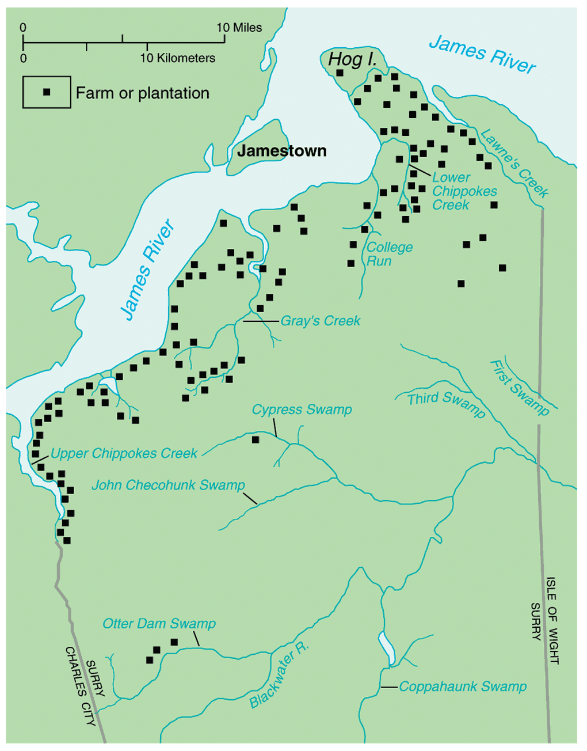
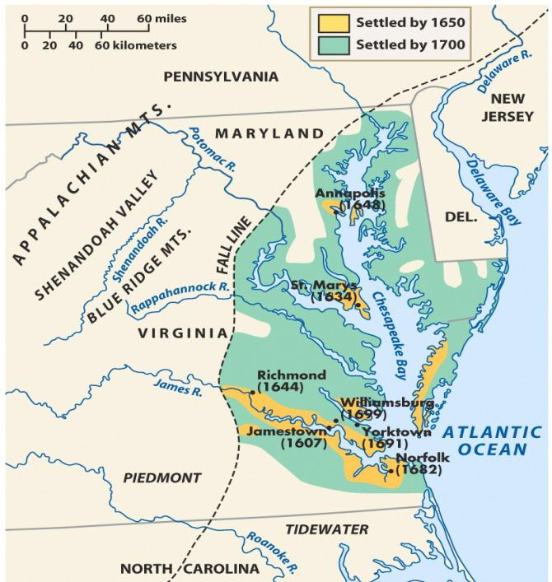
Tobacco was so profitable that colonists planted more, built large plantations, & expanded into new farm lands
Due to the success of tobacco, the Jamestown settlement expanded into the Virginia colony
Label on your map: Virginia & write why the colony was founded

Slide 7
Quick discussion: How did Jamestown settlers find enough workers to plant, harvest, and package large amounts of tobacco?

Slide 8
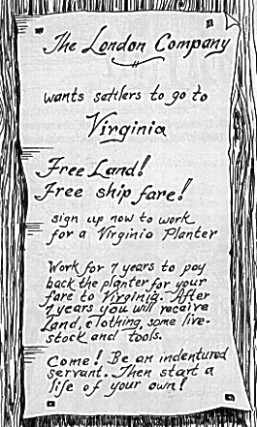
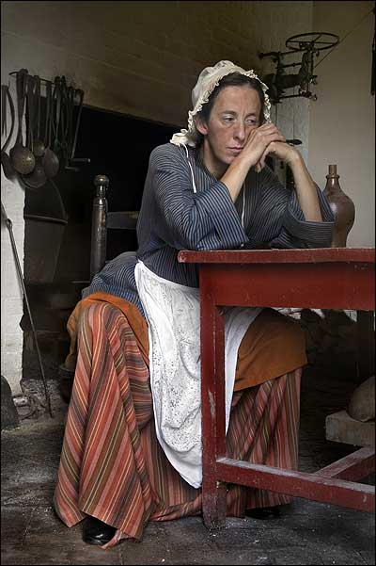
Tobacco created a need for field laborers to plant & pick the tobacco
To meet the demand for workers, landowners in Virginia used indentured servants from England
Indentured servants were typically poor men or women who agreed to work for a land owner for 4 to 7 years in exchange for their travel to America

Slide 9
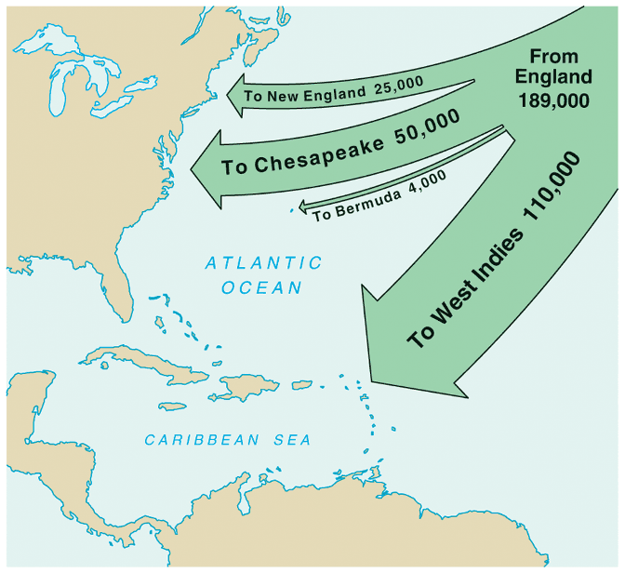
In 1618, Virginia introduced the Headright System which gave 50 acres to anyone who brought an indentured servant to America
The large population of poor people in Britain led thousands of people to immigrating as indentured servants by 1700
Indentured servants were worked hard, treated badly, & many died before their contracts ended
Notes:
Virginia’s growth was due largely to the headright system & indentured servitude
The status of indentured servants in early Virginia and Maryland was not wholly dissimilar from slavery. Servants could be bought, sold, or leased. They could also be physically beaten for disobedience or running away. Unlike slaves, however, they were freed after their term of service expired, their children did not inherit their status, and they received a small cash payment of "freedom dues."

Slide 10
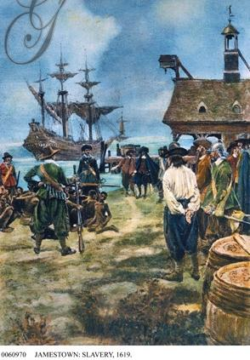
In addition to indentured servants, Virginia landowners also used African slaves who were first brought to Jamestown in 1619
In the mid-1600s, fewer indentured servants came to America as the British economy improved; As a result, African slavery replaced indentured servitude as the dominant labor system in Virginia

Slide 11
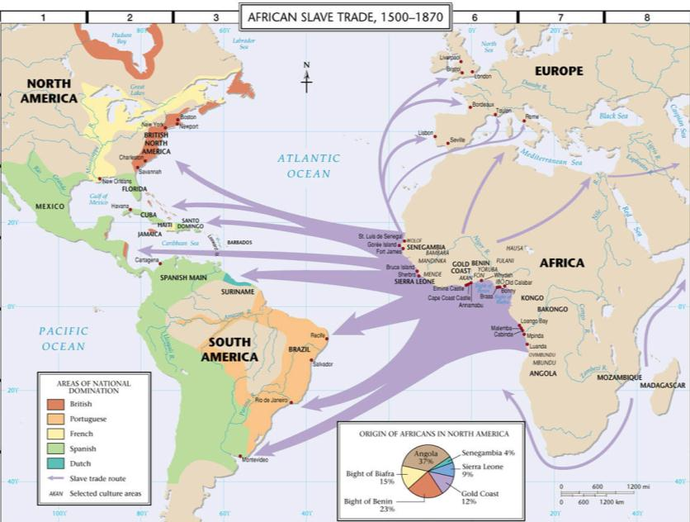
African slaves were transported from Africa to America on slave ships across the “Middle Passage”

Slide 12
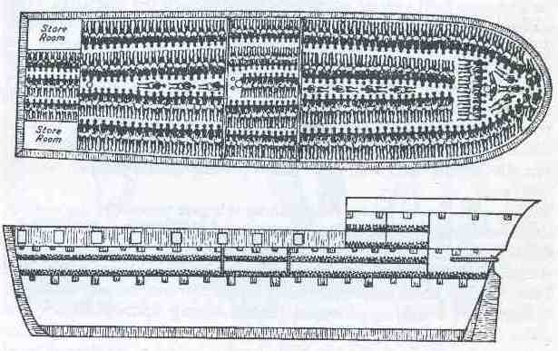
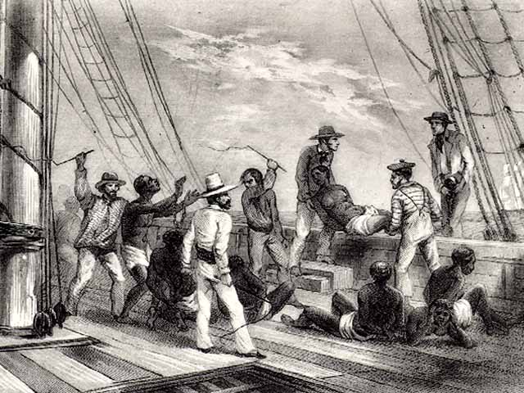
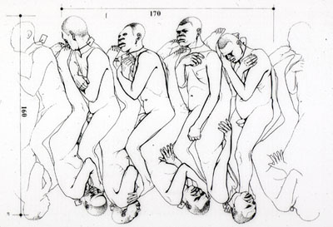
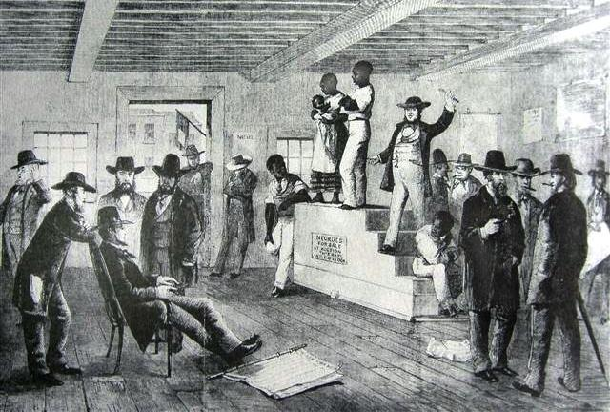
The “Coffin” Position Used Below Desk
African Captives Being Thrown Overboard
Slave auction upon arrival in America

Slide 13
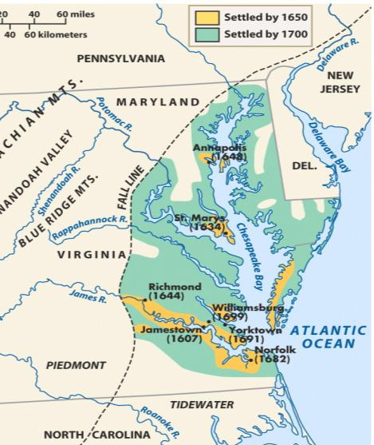
Quick discussion: As the Virginia colony grew, it needed government. What do you think the colonial government looked like? Who had power?

Slide 14
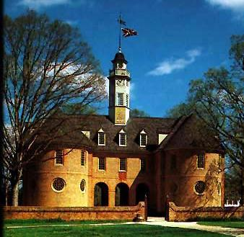
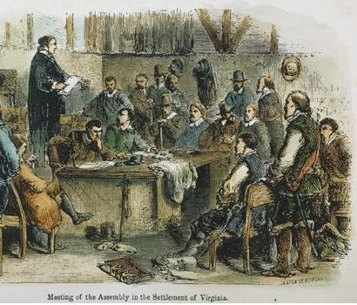
Virginia colonists needed laws to maintain order but the British government was thousands of miles across the Atlantic Ocean
In 1619, Virginians formed the House of Burgesses which was the first legislative assembly in America
Virginia was a royal colony so it had a governor chosen by the king, but the House of Burgesses made the important decisions regarding taxes & laws

Slide 15
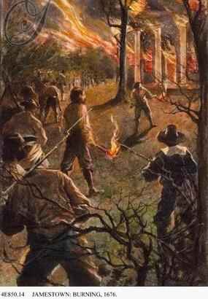
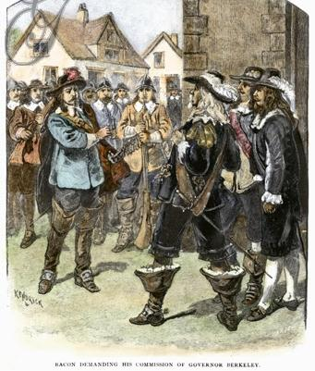
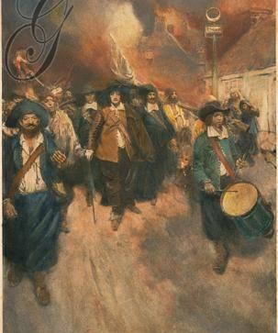
Even though the leaders of the House of Burgesses were elected, they were rich planters who did not always represent the poor farmers of the colony
Former indentured servants in western Virginia suffered from low tobacco prices & frequent Indian attacks
Poor farmers, led by Nathaniel Bacon, blamed Virginia’s governor for not protecting them & started a rebellion
Bacon’s Rebellion proved to rich Virginians that slaves were better than indentured servants because slaves would never ask for land

Slide 16
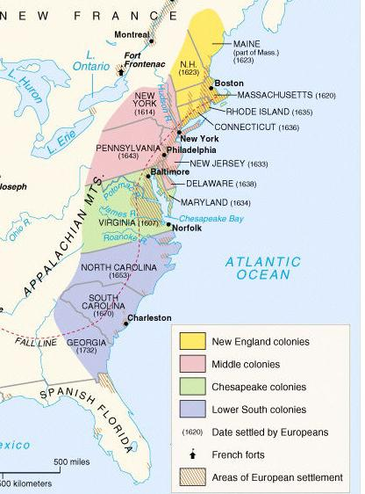
The Middle & Lower South Colonies
Notes:
Explain the development of the mid-Atlantic colonies; include the Dutch settlement of New Amsterdam and subsequent English takeover, and the settlement of Pennsylvania.

Slide 17
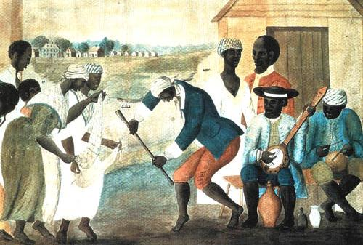
The image below is from the “Lower South” colony of South Carolina. Which other colony might it be similar to? Why?

Slide 18
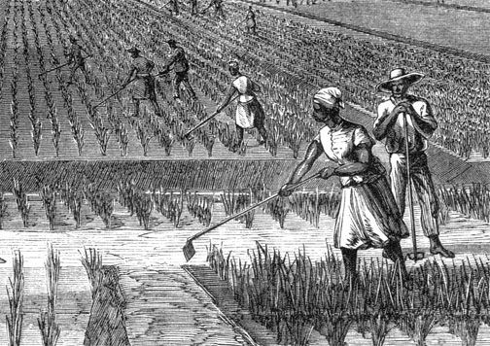
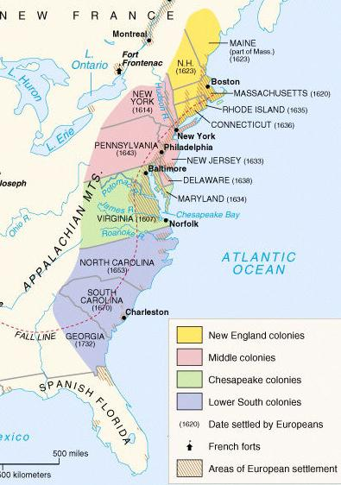
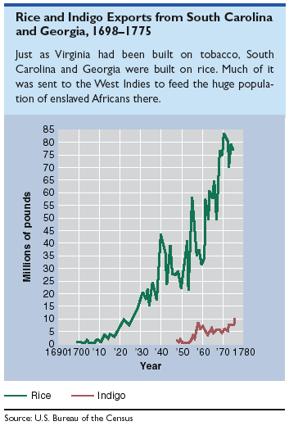
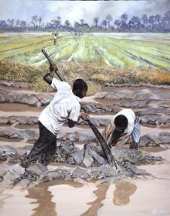
The Lower South colonies were the last British colonies to be formed
The Carolinas & Georgia developed like Virginia with a cash crop economy, slavery, & gaps between rich & poor colonists
Georgia was created by James Oglethorpe as a buffer colony between Carolina & Spanish Florida & was populated by British debtors & prisoners

Slide 19
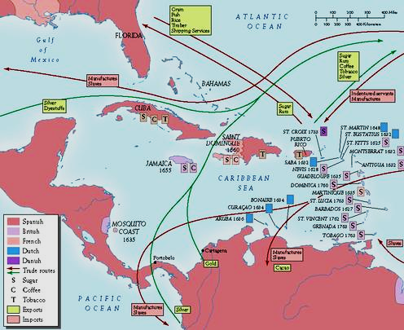
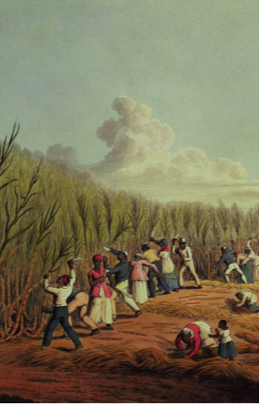
Colonies like Barbados & Jamaica were profitable, producing sugar for Britain
In addition to the 13 colonies, Britain had colonies in the Caribbean

Slide 20
Label on map: (a) New York
(b) Pennsylvania (c) North Carolina (d) South Carolina
(e) Georgia
(f) Group and label
the Middle & Southern colonies
(g) Label why these
colonies were
founded

Slide 21
Closure Activity
Specialization and Trade in the Thirteen Colonies (Understanding Economics in U.S. History, Lesson 6)

Slide 22
Closure Activity
Complete “Comparing the American Colonies” chart

