Slide 1
Key Issues
Why do industries face problems?

Slide 2
Industrial Problems
Global perspective
Stagnant demand
Increased capacity
More developed countries
Trading blocs
Disparities within trading blocs
Less developed countries
Old problems for LDCs
New problems for LDCs

Slide 3
Stagnant Demand
From the Industrial Revolution’s beginnings in the late 1700s until the 1970s, industrial growth in more developed countries was fueled by long-term increases in population and wealth.
The growth formula was simple: More people with more wealth demanded more industrial goods.
However, demand for many manufactured goods has slowed in MDCs during the past quarter century.
More developed countries now have little, if any, population growth.
Wages have not risen as fast as prices during the past two decades.

Slide 4
World Steel Production, 1973
Fig. 11-21a: The U.S., Soviet Union, and Japan were the largest steel producers in 1973, and with the rest of Europe, accounted for 90% of global steel production.

Slide 5
Increased Capacity Worldwide
While demand for products such as steel has stagnated during the past quarter century, global capacity to produce them has increased.
Higher industrial capacity is primarily a result of two trends: the global diffusion of the Industrial Revolution and the desire by individual countries to maintain their production despite a global overcapacity.
Historically, manufacturing was concentrated in a few locations.
Industrial growth through increased international sales was feasible when most of the world was organized into colonies and territories controlled by MDCs.
Few colonies remain in the world today, and nearly every independent country wants to establish its own industrial base.

Slide 6
Steel Production, 1973 and 2002
Fig. 11-21b: About 60% of global steel production takes place in MDCs in 2002, compared to 90% in 1973. Growth of steel manufacturing in China has been especially dramatic.

Slide 7
Change in Steel Production, 1973–2002
Fig. 11-21c: Steel production has generally declined in MDCs and increased in LDCs, especially in China, India, Brazil, and South Korea.

Slide 8
Industrial Problems in More Developed Countries
Countries at all levels of development face a similar challenge: to make their industries competitive in an increasingly integrated global economy.
Each state faces distinctive geographical issues in ensuring that their industries compete effectively.

Slide 9
Impact of Trading Blocs
Industrial competition in the more developed world increasingly occurs not among individual countries, but within regional trading blocs.
The three most important trading blocs are the Western Hemisphere, Western Europe, and East Asia.
Within each bloc, countries cooperate in trade.
Each bloc then competes against the other two.

Slide 10
Cooperation within Trading Blocs
The North Atlantic Free Trade Agreement brought Mexico into the free trade zone with the United States and Canada.
The three NAFTA partners have been negotiating with other Latin American countries.
The European Union has eliminated most barriers to trade through Western Europe.
Cooperation among countries is less formal in East Asia, in part because Japan’s neighbors have much lower levels of economic development and unpleasant memories of Japanese military aggression during the 1930s and 1940s.
The free movement of most products across the borders has led to closer integration of industries within North America and within Western Europe.

Slide 11
Competition among Trading Blocs
The three trading blocs have promoted internal cooperation, yet they have erected trade barriers to restrict other regions from competing effectively.
Faced with a decline in domestic steel production of about one-third during the late 1970s, the U.S. government negotiated a series of voluntary export-restraint agreements with other major steel-producing countries.
When these quotas were in effect—from 1982 until 1992U.S. steel companies spent $24 billion modernizing their plants and buying more efficient equipment.
The number of steelworkers fell by two-thirds.
Steel towns have suffered severely from this decline.
Declines in other manufacturing sectors in MDCs have had similar impacts in their communities.

Slide 12
Transnational Corporations
Cooperation and competition within and among trading blocs take place primarily through the actions of large transnational corporations, sometimes called multinational corporations.
Initially, transnational corporations were primarily American-owned, but in recent years especially Japan, Germany, France, and the United Kingdom have been active as well.
Some transnational corporations locate factories in other countries to expand their markets.
Transnational corporations also open factories in countries with lower site factors to reduce their production cost.
The site factor that varies most dramatically among countries is labor.
Japanese transnational corporations have been especially active in the United States in recent years.
Most plants have been located in a handful of interior states, including Ohio, Indiana, Kentucky, Michigan, Tennessee, and Illinois. German transnationals have clustered in the Carolinas.

Slide 13
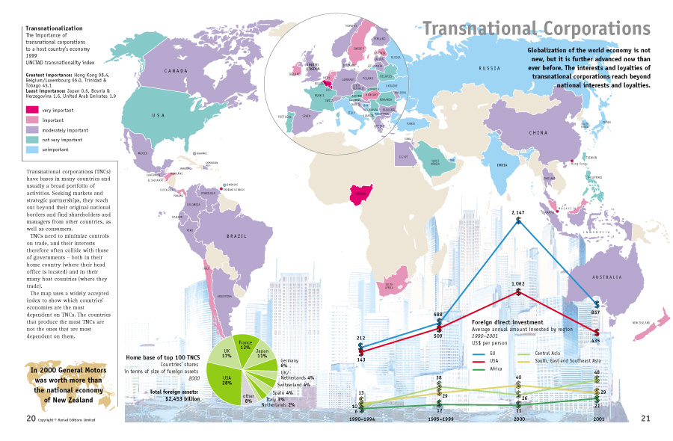

Slide 14
Disparities within Trading Blocs
One country or region within a country may have lower levels of income and amenities because it has less industry than other countries or regions within the trading bloc.
Disparities within Western Europe. Europe’s most important industrial areas, such as western Germany and northern Italy, are relatively wealthy.
Disparities exist at the scale of the individual country as well.
Industry is concentrated in the regions most accessible to Western Europe’s core of population, wealth, and industry.
Germany has had a particularly difficult problem with regional disparities, a legacy of Communist-run East Germany (German Democratic Republic).
The European Union, through its European Regional Development Fund, assists its three least industrialized member countries—Greece, Ireland, and Portugal—as well as regions in three other countries that lack industrial investment—Northern Ireland (part of the United Kingdom), southern Italy, and most of Spain.
Funds also aid a number of declining industrial areas.
A number of Western European countries use incentives to lure industry into poorer regions and discourage growth in the richer regions.

Slide 15
Disparities within the United States
The problem of regional disparity is somewhat different in the United States.
The South, historically the poorest U.S. region, has had the most rapid growth since the 1930s, stimulated partly by government policy and partly by changing site factors.
The Northeast, traditionally the wealthiest and most industrialized region, claims that development in the South has been at the expense of old industrialized communities in New England and the Great Lakes states.
Regional development policies scored some successes as long as national economies were expanding overall, because the lagging regions shared in the national growth.
But in an era of limited economic growth for MDCs, govermnents increasingly questioned policies that strongly encourage industrial location in poorer regions.

Slide 16
Industrial Problems in Less Developed Countries
Knowing that their agriculture-based economies offer limited economic growth, the leaders of virtually every LDC encourage new industry.
In some respects, LDCs face obstacles similar to those once experienced by today’s MDCs.
One of the biggest issues is distance from markets.
To minimize geographic isolation, industrializing countries invest scarce resources in constructing and subsidizing transportation facilities.
Another issues is inadequate infrastructure.
The LDCs obtain support services by importing advisers and materials from other countries, or by borrowing money to develop domestic sources.

Slide 17
New Problems for LDCs
In addition, industrializing countries now face a new obstacle.
Few untapped foreign markets remain to be exploited.
New industries must sell primarily to consumers inside their own country.
According to principles of economic geography, (in addition to market access), there are two other critical locational factors: access to raw materials and site factors.
In fact, new African factories generally are those for which these factors are critical: (1) raw material access, (2) site factors.
Transnational corporations have been especially aggressive in using low-cost labor in LDCs.
Transnational corporations can profitably transfer some work to LDCs, despite greater transportation cost.
Operations that require highly skilled workers remain in factories in MDCs.
This selective transfer of some jobs to LDCs is known as the new international division of labor.
Many African countries possess iron ore.
But steel, perhaps the most important industry for a less developed country, has had difficulty getting a foothold in Africa.
Without cooperation among several small states, steel manufacturing is not likely to develop further in Africa.

