Slide 1
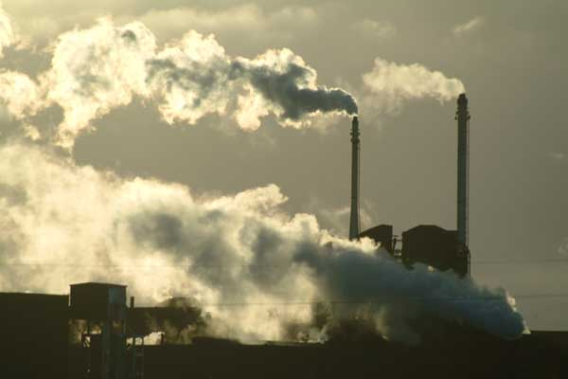
Key Issues
Where is industry distributed?

Slide 2
World Industrial Regions
North America
  Industrialized areas in North America
  Changing distribution of U.S. manufacturing
Europe
  Western Europe
  Eastern Europe
East Asia

Slide 3
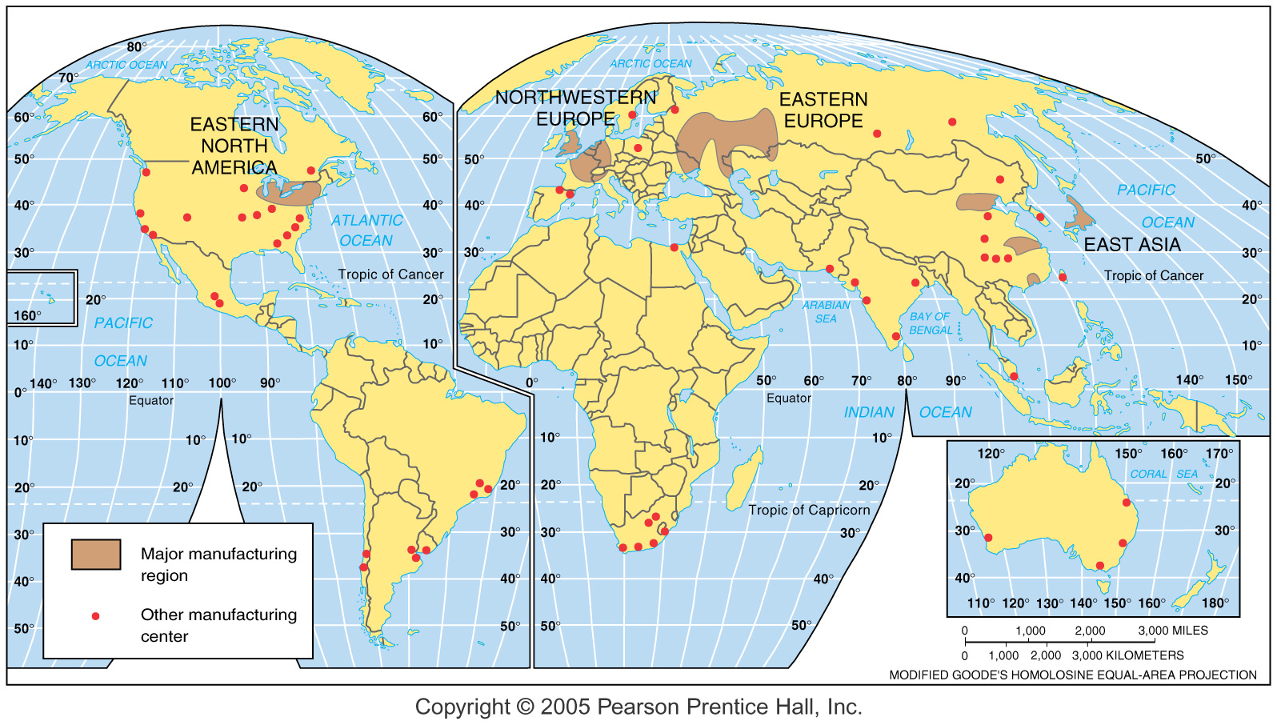
Manufacturing Regions
Fig. 11-3: The world’s major manufacturing regions are found in North America, Europe, and East Asia. Other manufacturing centers are also found elsewhere.

Slide 4
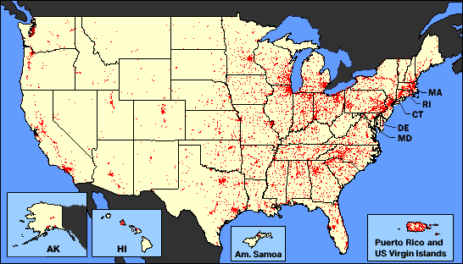
North America
Manufacturing in North America is concentrated in the northeastern quadrant of the United States and in southeastern Canada.
Only 5 percent of the land area of these countries.., contains one-third of the population and nearly two-thirds of the manufacturing output.
This manufacturing belt has achieved its dominance through a combination of historical and environmental factors.
Early. . . settlement gave eastern cities an advantage. . . to become the country’s dominant industrial center.
The Northeast also had essential raw materials. . . and good transportation.
The Great Lakes and major rivers. . . were supplemented in the 1 800s by canals, railways, and highways.

Slide 5
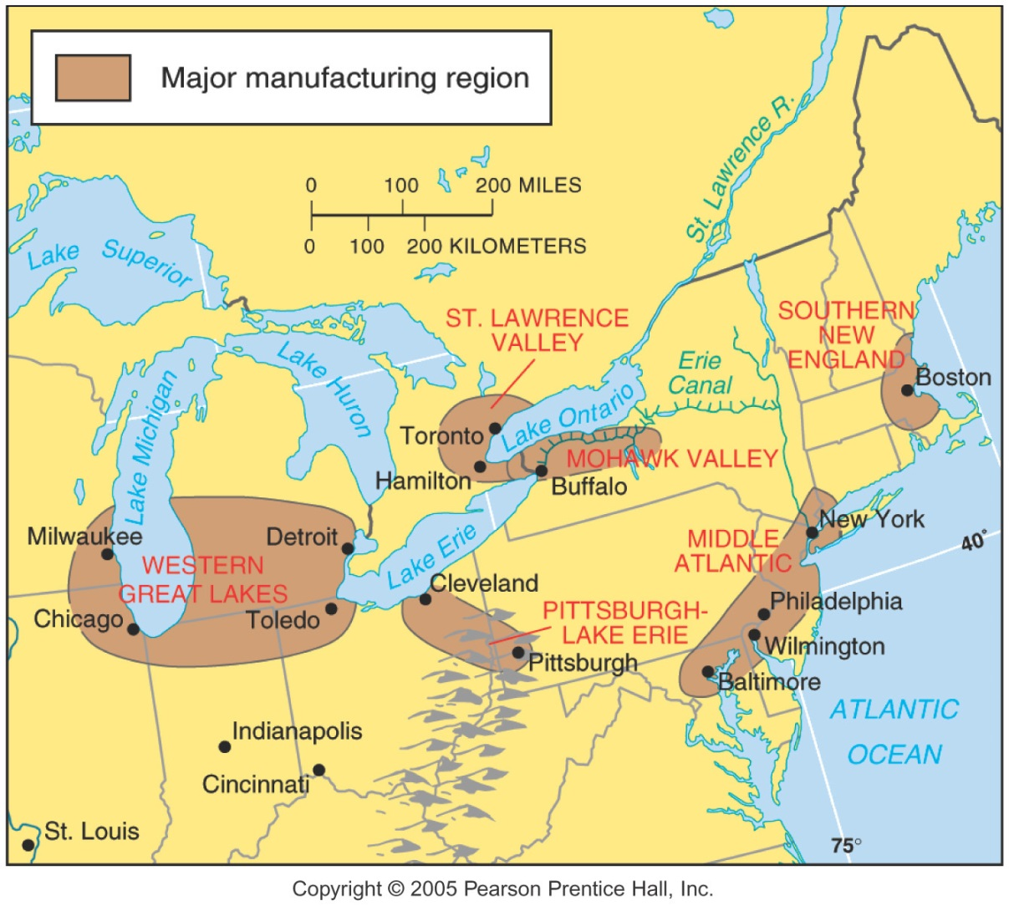
Industrial Regions of North America
Fig. 11-4: The major industrial regions of North America are clustered in the northeast U.S. and southeastern Canada, although there are other important centers.

Slide 6
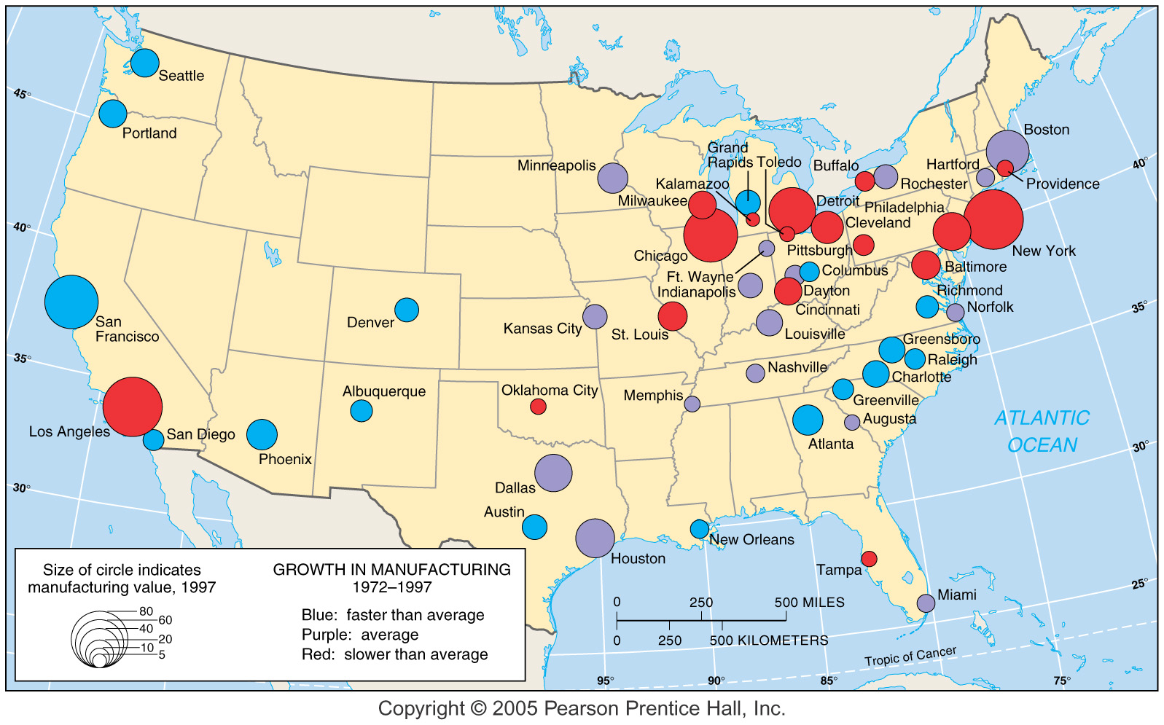
Manufacturing Value Change
Fig. 11-5: The value and growth of manufacturing in major metropolitan areas in the U.S. between 1972 and 1997.

Slide 7
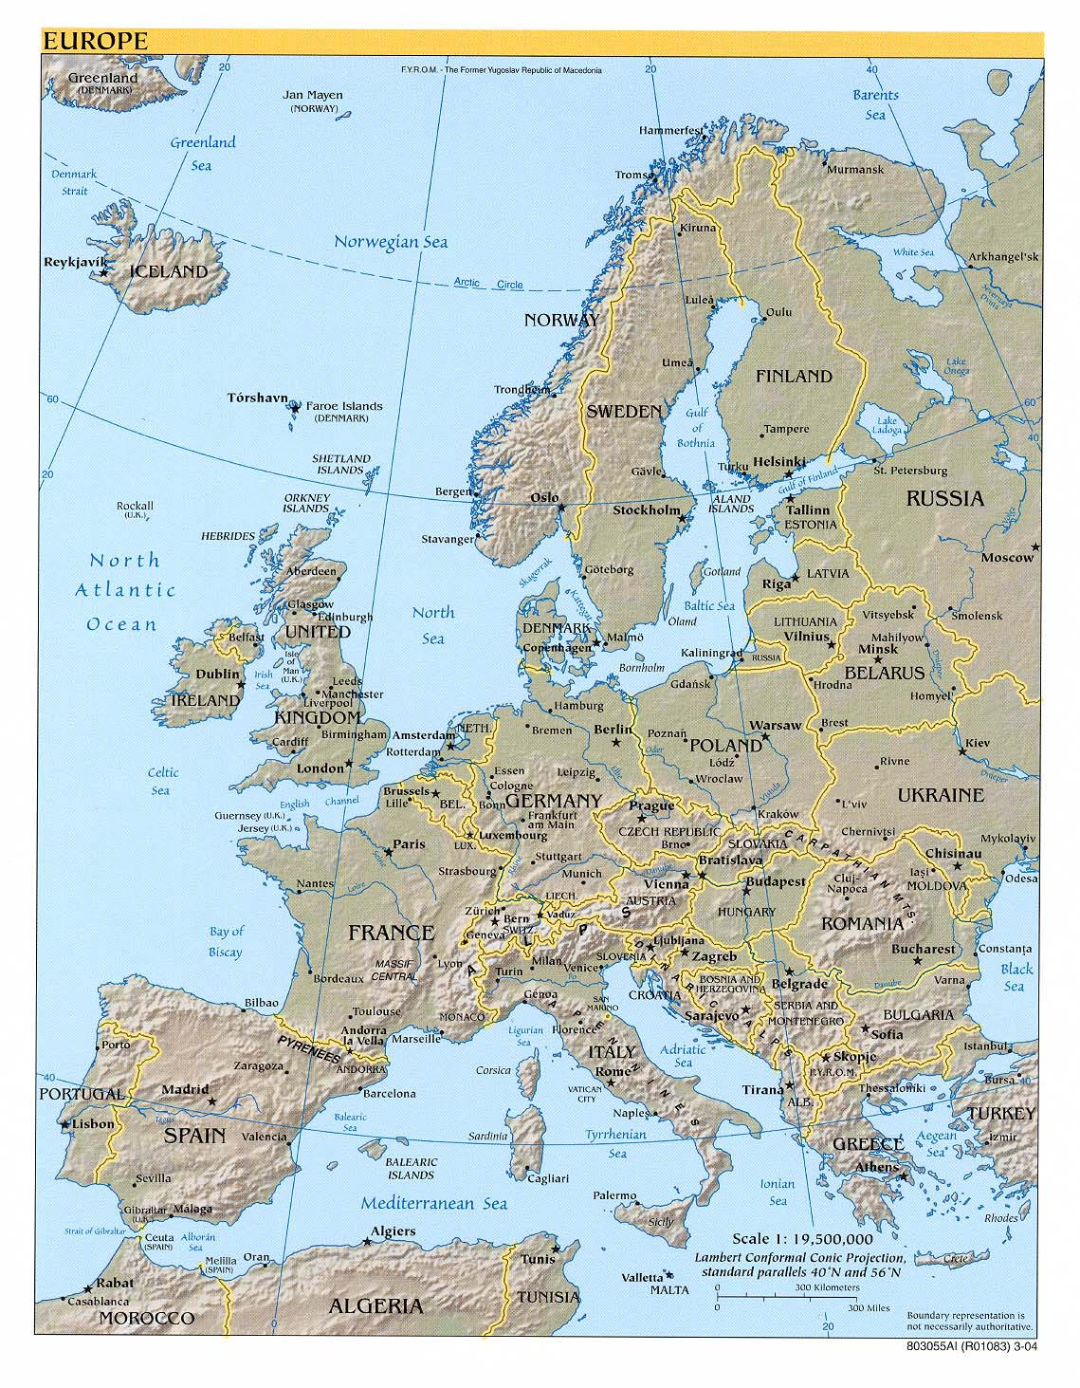
Europe and Manufacturing
The Western European industrial region appears as one region on a world map.
In reality, four distinct districts have emerged, primarily because European countries competed with one another to develop their own industrial areas.
Eastern Europe has six major industrial regions.
Four are entirely in Russia, one is in Ukraine, and one is southern Poland and northern Czech Republic.

Slide 8
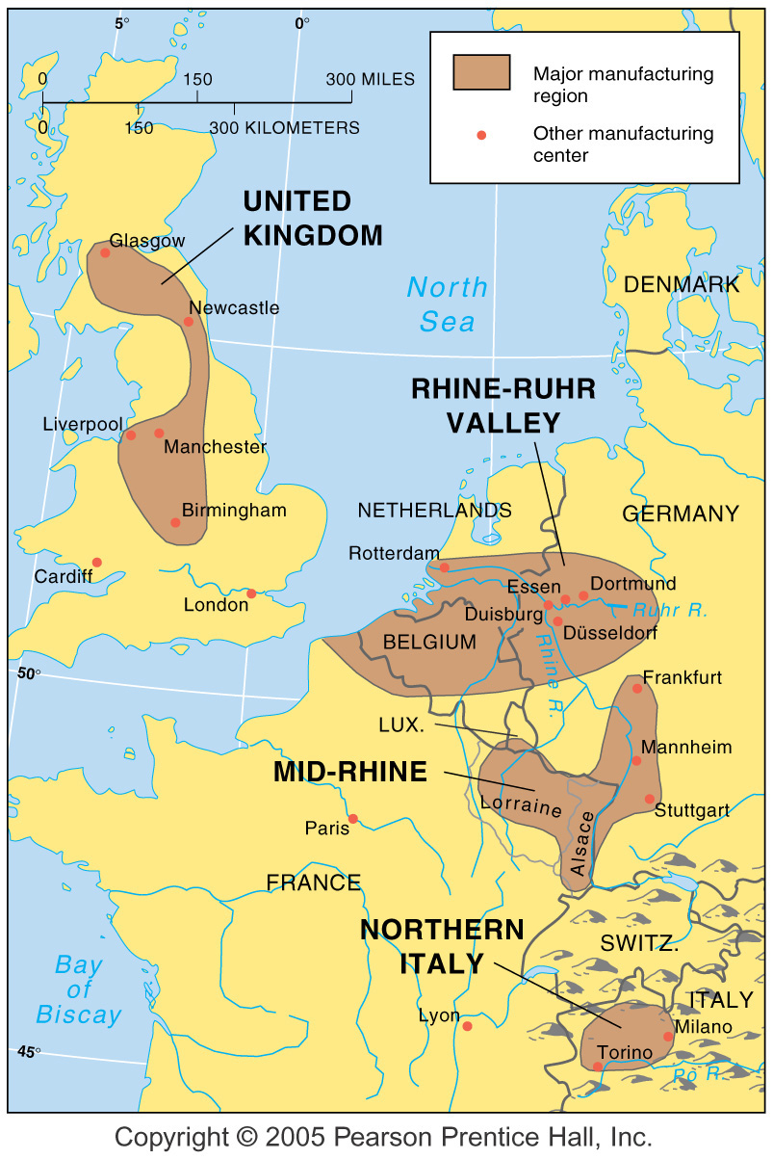
Manufacturing Centers in Western Europe
Fig. 11-6: The major manufacturing centers in Western Europe extend in a north-south band from Britain to Italy.

Slide 9
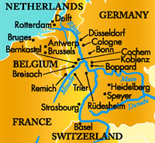
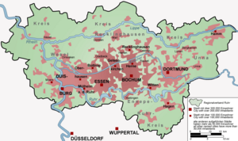
Rhine—Ruhr Valley
  Western Europe’s most important industrial area is the Rhine—Ruhr Valley... in northwestern Germany, Belgium, France, and the Netherlands.
  Within the region, industry is dispersed rather than concentrated in one or two cities.
  No individual city has more than one million inhabitants.
  The Rhine divides into multiple branches as it passes through the Netherlands.
  The city of Rotterdam is near to where several major branches flow into the North Sea.
  This location at the mouth of Europe’s most important river has made Rotterdam the world’s largest port.
  Iron and steel manufacturing has concentrated in the Rhine—Ruhr Valley because of proximity to large coalfields.
  Access to iron and steel production stimulated the location of other heavy-metal industries, such as locomotives, machinery, and armaments.

Slide 10
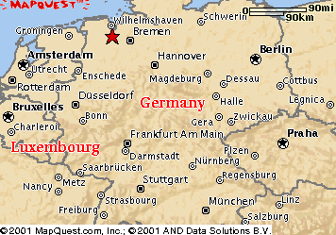
Mid-Rhine
The second most important industrial area in Western Europe includes southwestern Germany, northeastern France, and the small country of Luxembourg.
In contrast to the Rhine—Ruhr Valley, the German portion of the Mid-Rhine region lacks abundant raw materials, but it is at the center of Europe’s most important consumer market.
The French portion of the Mid-Rhine region—Alsace and Lorraine—contains Europe’s largest iron- ore field and is the production center for two-thirds of France’s steel.
Tiny Luxembourg is also one of the world’s leading steel producers, because the Lorraine iron-ore field extends into the southern part of the country.

Slide 11
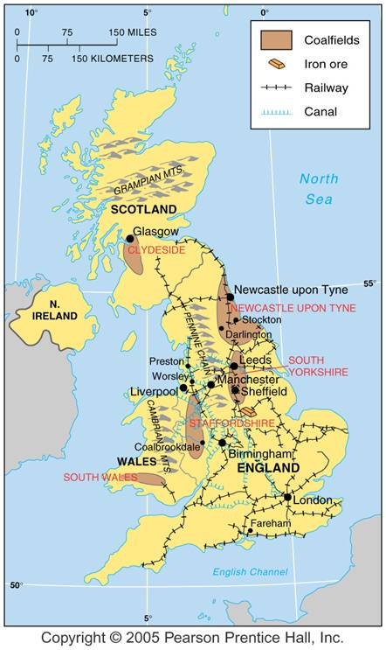
United Kingdom
The Industrial Revolution originated in the Midlands and northern England and southern Scotland, in part because those areas contained a remarkable concentration of innovative engineers and mechanics during the late eighteenth century.
The United Kingdom lost its international industrial leadership in the twentieth century.
Britain was saddled with outmoded and deteriorating factories and their “misfortune” of winning World War II.
The losers, Germany and Japan, received American financial assistance to build modern factories, replacing those destroyed during the war.
The United Kingdom expanded industrial production in the late twentieth century by attracting new high-tech industries that serve the European market.
Japanese companies have built more factories in the United Kingdom than has any other European country.
Today British industries are more likely to locate in southeastern England near the country’s largest concentrations of population and wealth and the Channel Tunnel.

Slide 12
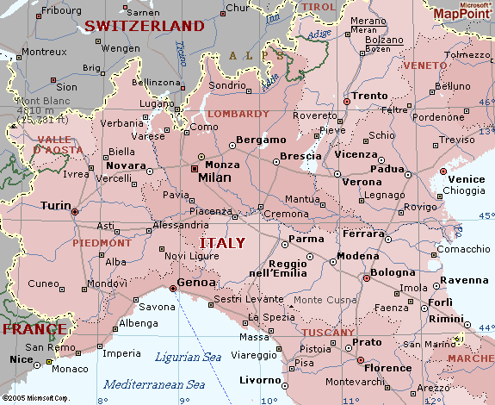
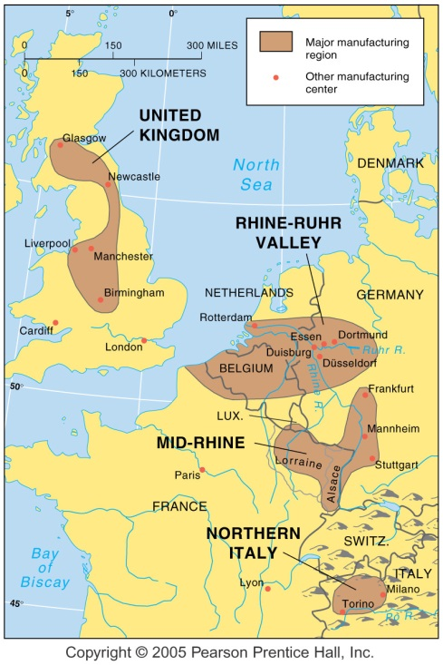
Northern Italy
A fourth European industrial region of some importance lies in the Po River Basin of northern Italy.
Modern industrial development in the Po Basin began with establishment of textile manufacturing during the nineteenth century because of two key assets: numerous workers and inexpensive hydroelectricity.

Slide 13
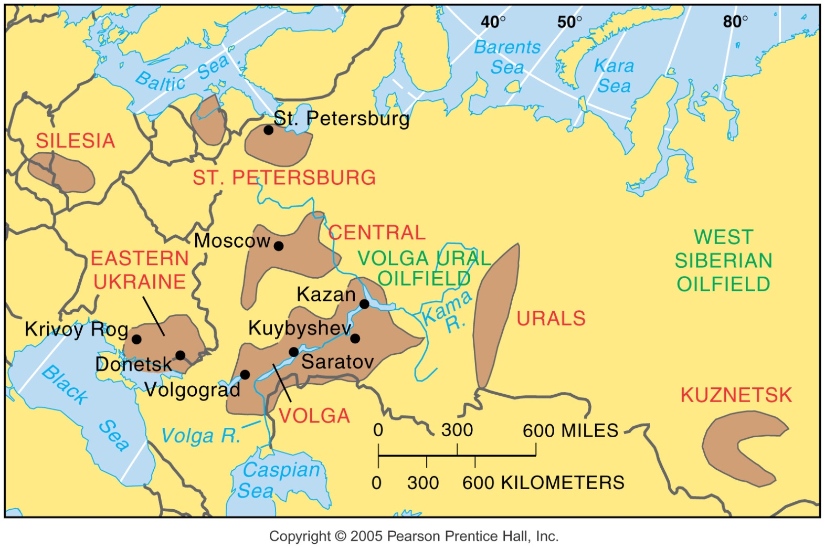
Manufacturing Centers in Eastern Europe and Russia
Fig. 11-7: Major manufacturing centers are clustered in European Russia and the Ukraine. Other centers were developed east of the Urals.

Slide 14
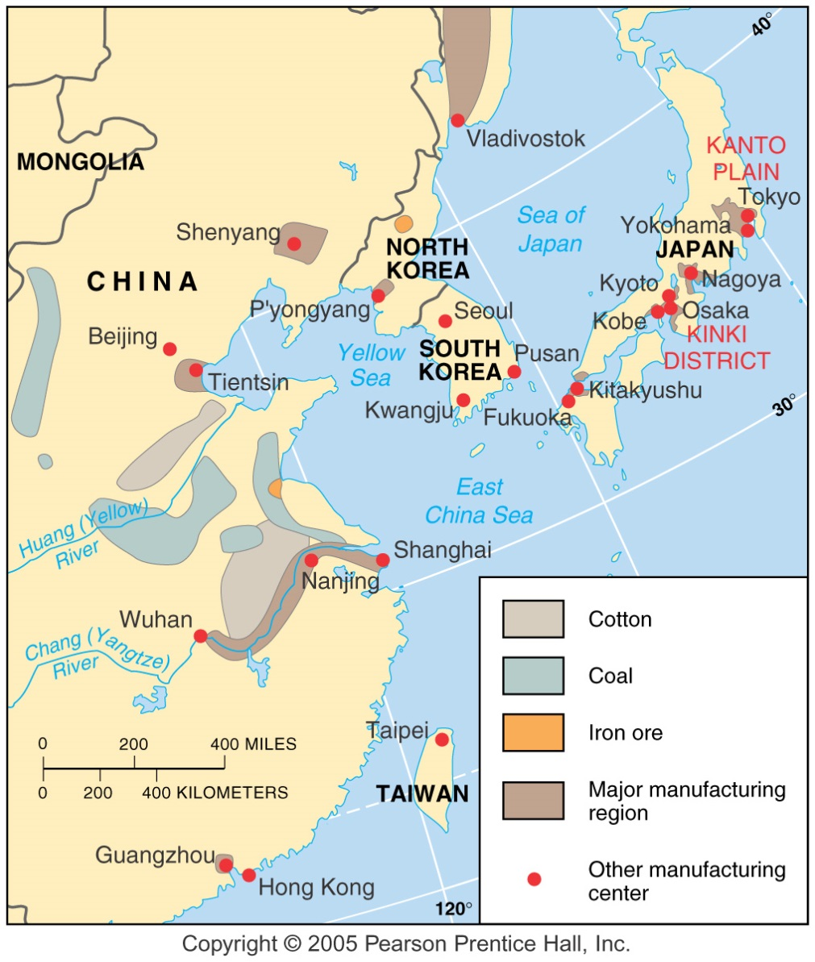
Manufacturing Centers in East Asia
Fig. 11-8: Many industries in China are clustered in three centers near the east coast. In Japan, production is clustered along the southeast coast.

