Slide 1
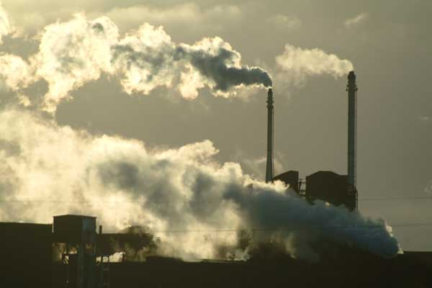
Key Issues
Where did industry originate?

Slide 2
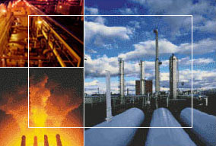
Factory Locations
Two connections are critical in determining the best location for a factory: where the markets for the product are located, and where the resources needed to make the product are located.
A generation ago, industry was highly clustered in a handful of more developed countries, but industry has diffused to less developed countries.
Geographers identify a community’s assets that enable it to compete successfully for industries, as well as handicaps that must be overcome to retain older companies.

Slide 3
Origin and Diffusion of the Industrial Revolution
The Industrial Revolution
Diffusion of the Industrial Revolution
  Diffusion from the iron industry
  Diffusion from the textile industry
  Diffusion from the United Kingdom

Slide 4
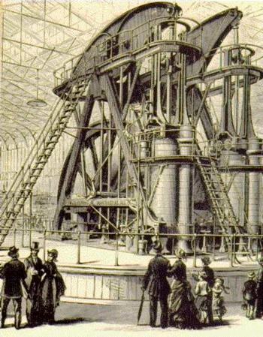
The Industrial Revolution
From its beginnings in the north of the United Kingdom around 1750, the Industrial Revolution diffused to Europe and North America in the nineteenth century and to the rest of the world in the twentieth century.
The Industrial Revolution resulted in new social, economic, and political inventions, not just industrial ones.
Prior to the Industrial Revolution, industry was geographically dispersed across the landscape.
Home-based manufacturing was known as the cottage industry system.
The Industrial Revolution was the collective invention of hundreds of mechanical devices.

Slide 5
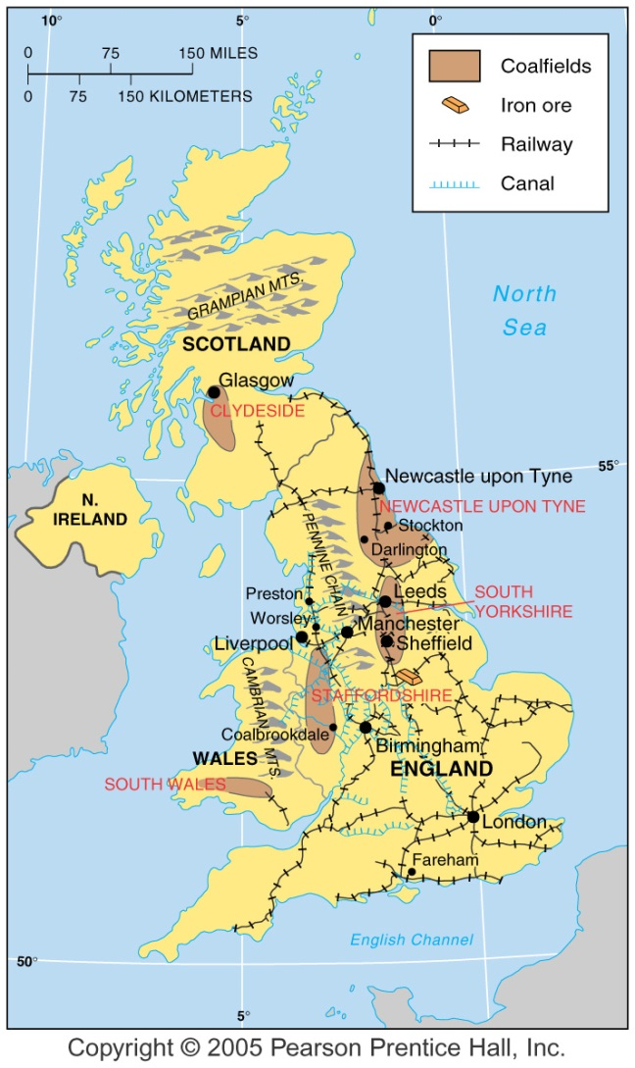
Industrial Revolution Hearths
The iron industry was first to increase production through extensive use of (James) Watt’s steam engine, plus other inventions.
The textile industry followed.
From these two pioneering industries, new industrial techniques diffused during the nineteenth century.
Fig. 11-1: The Industrial Revolution originated in areas of northern England. Factories often clustered near coalfields.

Slide 6
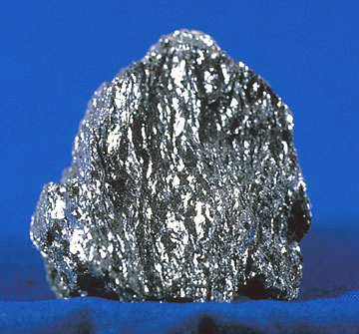
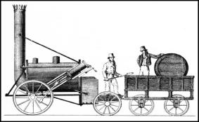
Diffusion from the Iron Industry
Iron ore is mined from the ground.
The ore is not in a useful form for making tools, so it has to be smelted (melted) in a blast furnace (blasted with air to make its fires burn hotly).
Henry Cort... patented two processes, known as puddling and rolling, in 1783, . . . to remove carbon and other impurities.
The combination of Watt’s engine and Cort’s iron purification process increased iron manufacturing capability.
The needs of the iron industry in turn generated innovations in coal mining, engineering, transportation, and other industries.
These inventions in turn permitted the modernization of other industrial activities.

Slide 7


Coal
Wood, the main energy source prior to the Industrial Revolution, became increasingly scarce because it was needed for construction of ships, buildings, and furniture, as well as for heat.
High- energy coal. . . was plentiful. Because of the need for large quantities of bulky, heavy coal, the iron industry’s geographic pattern changed from dispersed to clustered.
These factories clustered at four locations.
Each site was near a productive coalfield.

Slide 8
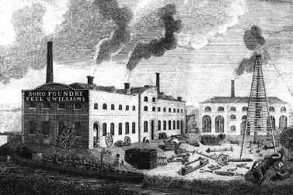
Engineering
In 1795 James Watt decided to go into business for himself rather than serve as a consultant to industrialists.
He and Matthew Boulton established the Soho Foundry at Birmingham, England, and produced hundreds of new machines.
From this operation came our modern engineering and manufacture of machine parts.

Slide 9
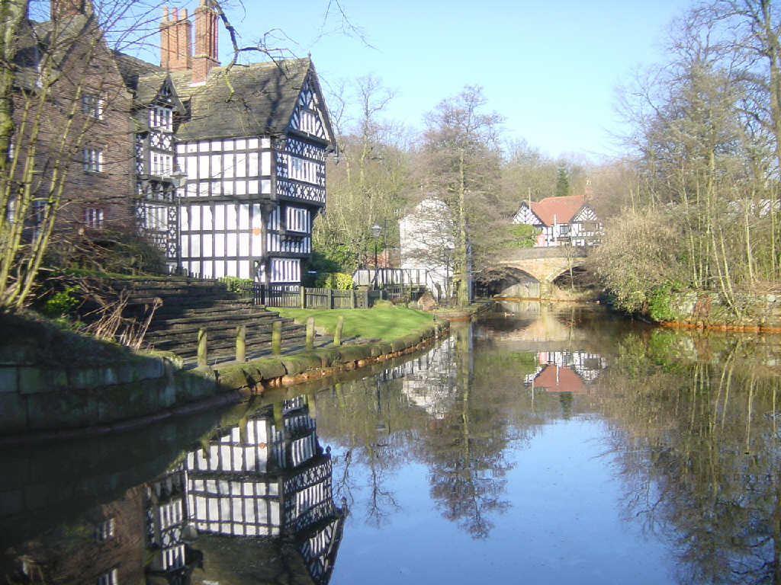
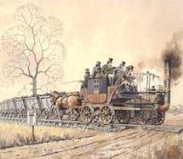
Transportation
The new engineering profession made its biggest impact on transportation, especially canals and railways.
In 1759 Francis Egerton, the second Duke of Bridgewater, decided to build a canal between Worsley and Manchester.
This feat launched a generation of British canal construction.
The canals soon were superseded by the invention of another transportation system, the railway, or “iron horse.”
The railway was not invented by one individual, but through teamwork.
Two separate but coordinated engineering improvements were required: the locomotive, and iron rails for it to run on.
The first public railway was opened between Stockton and Darlington in the north of England in 1825.

Slide 10
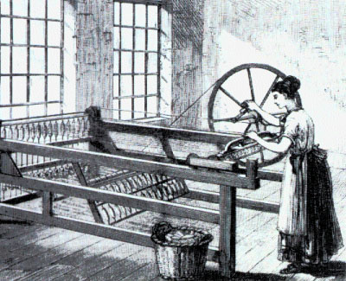
Diffusion from the Textile Industry
A series of inventions between 1760 and 1800 transformed textile production from a dispersed cottage industry to a concentrated factory system.
Richard Arkwright. . . improved the process of spinning yarn.
He produced a spinning frame in 1768 . . . then . . . a process for carding (untwisting the fibers prior to spinning).
These two operations required more power than human beings could provide.
The textile industry joined the iron industry early in adopting Watt’s steam engine.
From the clothing industry’s need for new bleaching techniques emerged another industry that is characteristic of the Industrial Revolution: chemicals.

Slide 11
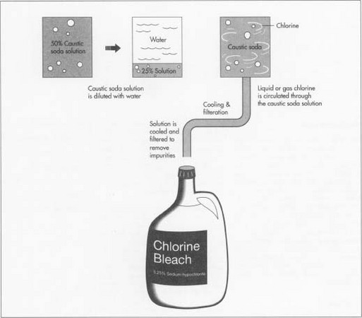
Chemicals
The traditional method of bleaching cotton involved either exposing the fabric to the Sun or boiling it,. . . first. . . in a solution of ashes and then in sour milk.
In 1746 John Roebuck and Samuel Garbett established a factory in which sulfuric acid, obtained from burning coal, was used instead of sour milk.
In 1798 Charles Tennant, who produced a bleaching powder made from chlorine gas and lime, a safer product than sulfuric acid.
Sulfuric acid was also used to dye clothing.
Combined with various metals, sulfuric acid produced another acid, called vitriol, the color of which varied with the metal,. . . blue with copper, green with iron, and white with zinc.
Natural-fiber cloth, such as cotton and wool, is now combined with chemically produced synthetic fibers,. . . made from petroleum or coal derivatives.
Today the largest textile factories are owned by chemical companies.

Slide 12
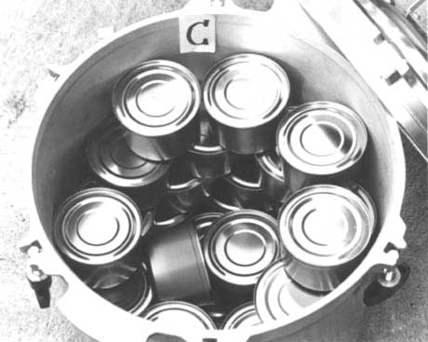
Food Processing
Another industry derived from the chemical industry is food processing.
Canning requires high temperature over time. . . some four to five hours, depending on the product.
This is where chemical experiments contributed.
Calcium chloride was added to the water, raising its boiling temperature from 100°C to 116°C (2 12°F to 240°F).
This reduced the time for proper sterilization to only 25 to 40 minutes.
Consequently, production of canned foods increased tenfold.

Slide 13
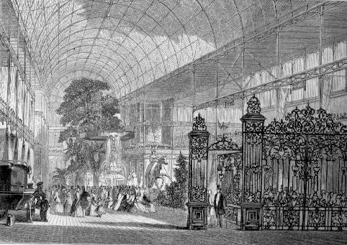
Diffusion from the United Kingdom
Britain’s Crystal Palace became the most visible symbol of the Industrial Revolution, built to house the 1851 “Great Exhibition of the Works of Industry of All Nations.”
When Queen Victoria opened the Crystal Palace, the United Kingdom was the world’s dominant industrial power.
From the United Kingdom, the Industrial Revolution diffused eastward through Europe and westward across the Atlantic Ocean to North America.
From these places, industrial development continued diffusing to other parts of the world.

Slide 14
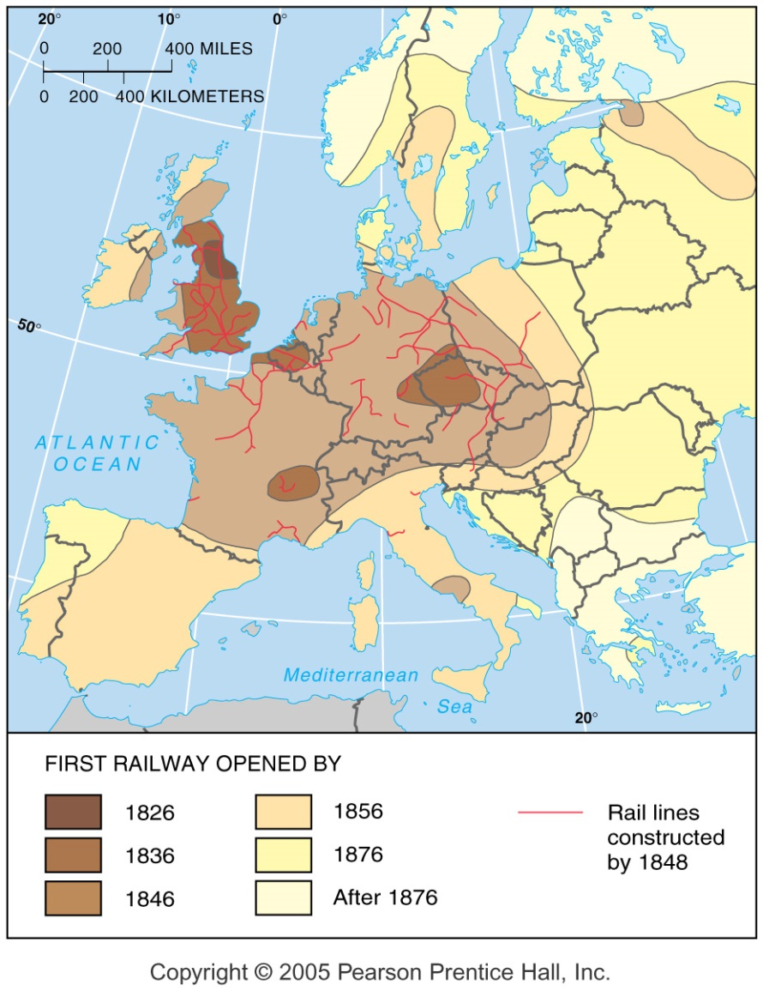
Diffusion of Railways
Europeans developed many early inventions of the Industrial Revolution in the late 1700s.
The Belgians led the way in new coal-mining techniques, the French had the first coal- fired blast furnace for making iron, and the Germans made the first industrial cotton mill.
Political instability delayed the diffusion of the Industrial Revolution in Europe.
Europe’s political problems retarded development of modern transportation systems, especially the railway.
Railways in some parts of Europe were delayed 50 years after their debut in Britain.
The Industrial Revolution reached Italy, the Netherlands, Russia, and Sweden in the late 1800s.
Other Southern and Eastern European countries joined the Industrial Revolution during the twentieth century.
Fig. 11-2: The year by which the first railway opened shows the diffusion of railways and the Industrial Revolution from Britain.

Slide 15
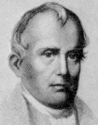

Diffusion to the United States
Industry arrived a bit later in the United States than in Western European countries like France and Belgium, but it grew much faster.
The first U.S. textile mill was built in Pawtucket, Rhode Island, in 1791, by Samuel S later, a former worker at Arkwright’s factory in England.
The textile industry grew rapidly after 1808, when the U.S. government imposed an embargo on European trade to avoid entanglement in the Napoleonic Wars.
The United States had become a major industrial nation by 1860, second only to the United Kingdom.
However, except for textiles, leading U.S. industries did not widely use the new industrial processes until the final third of the nineteenth century.
Although industrial development has diffused across Earth’s surface, much of the world’s industry is concentrated in four regions.

