Slide 1
Industrial Location Models
http://en.wikipedia.org/wiki/Alfred_Weber#Least_Cost_Theory http://en.wikipedia.org/wiki/Location_model#Hotelling.27s_Location_Model http://www.answers.com/topic/weber-s-theory-of-industrial-location http://www.answers.com/topic/hotelling-model
Overview: Industry seeks to maximize (Capitalize) profits by minimizing production costs. Two geographical costs are situation and site.
Situation factors involve transporting materials to and from a factory. Industry seeks a location that minimizes the cost of transporting inputs to the factory and finished goods to the consumers.
Site factors result from the unique characteristics of a location. Land, labor, and capital are the three traditional production factors that vary among locations.

Slide 2
Factors
Situation Factors: Industries locate near inputs to take advantage of certain natural resources and to reduce bulk. By placing a factory near an input, you can reduce the bulk of that product, such as copper. making it cheaper for transportation. So you would locate near the mines. Copper is a bulk-reducing industry, an economic activity in which the final product weighs less than the input. By locating your industry near the mine, one minimizes transportation costs because you are not sending heavy packages and products to customers. One a different note, industries also locate near markets to decrease transportation costs for bulk-gaining industries, where a product gains volume or weight during production. An example would be of canned foods, where it is cheaper to send tin cans to a canning plan a few miles away from the major market center. A break-of-bulk point is a location where transfer among transportation modes is possible. Manufacturers look for these when they are determining a location so that can minimize cost of transportation by rail, air, ship, or truck. Site Factors: Site factors include labor, land and capital. Industries search for labor that can maximize their profits by producing as much of a product as possible. A labor intensive industry is on in which labor cost is a high percentage of expense. Labor cost is consider a site factor. Manufacturers seek to reduce this expense percentage by higher unskilled laborers for less pay.

Slide 3
Alfred Weber
Industries use Alfred Weber’s least cost theory which emphasizes that firms seek a site of minimum transport and labor costs.
They look at three costs: Transportation costs, labor costs and agglomeration.
To Weber, transportation was the most important cost factor.
The reason why manufacturers try to locate near their buyers and sellers is to reduce the costs of transportation.
At the same time, they would try and minimize the costs of transporting in raw materials to their factories.
The further away you are located from your buyer and dealer, the higher the cost of your transportation to travel to and from them will be.
Industries will also look at the cost of labor, they will be willing to locate somewhere where they can hire people who will work for small wages because their jobs are not specialized, and do not take much skill.
If cheaper labor made up for transport costs, you would locate further away but only so far from your market as you had to in order to get cheap labor.

Slide 4
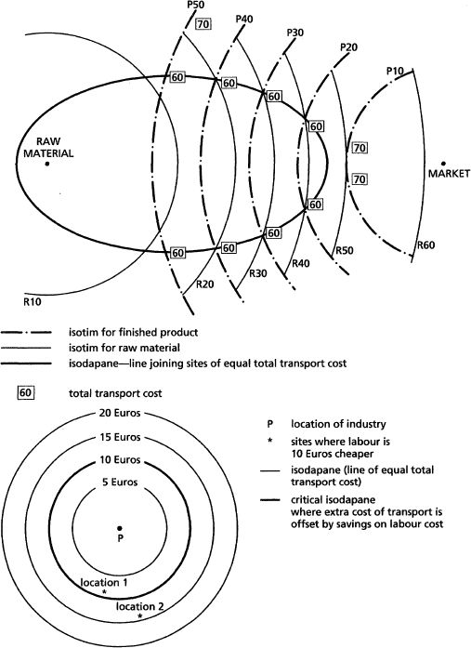
An example would be of the United States which locates its factories in places like Mexico where outsourcing workers means lower wages as well as still being close to the market and also taking advantage of a trading agreement (NAFTA).
By taking advantage of NAFTA, products from Mexico can be transported across the borders for free.
Agglomeration is also a factor that industries look at, because they will have fewer costs if they locate near other factories because each factory will in some ways share the costs.
Of course, if things got to expensive because too many factories wanted to be located in one area (increasing rents), deglomeration would occur.

Slide 5
Harold Hotelling
Hotelling’s location model deals with situation factors.
Proposed by H. Hotelling in 1939, the model shows the effect of competition on locational decisions. The model is usually based on two ice-cream salesmen, A and B, on a mile of beach.
The cost and choice of ice-cream is the same for each distributor. Buyers are evenly distributed along the beach.

Slide 6
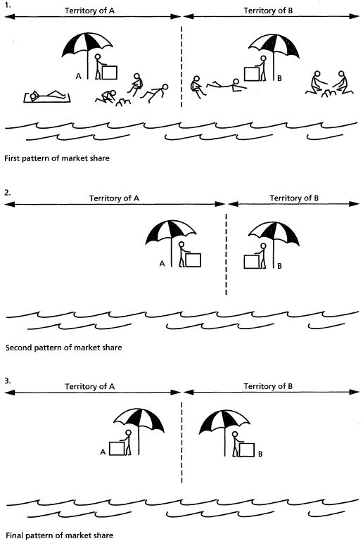
The first pattern of market share has the two salesmen positioned so that each is at the centre of his half of the beach and the market is split up evenly. If A now moves nearer to the middle of the beach, he will increase his market share.
The logical outcome of this will have both salesmen back to back at the centre of the beach, as long as some customers are willing to walk nearly half a mile for an ice-cream, i.e. that the consumer provides the transport.
This analogy indicates that locational decisions are not made independently but are influenced by the actions of others. So once one factory moves, more will move along with it (agglomeration) because industries want to be located near other industries similar to it (like Silicon Valley in California).
The main point of his model is that one cannot understand the location of an industry without reference to the other industries/businesses (of like kind). The above is just one example of how that can happen.
Note: It is also call LOCATIONAL INTERDEPENDENCE.

Slide 7
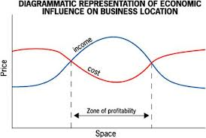
August Lösch
In 1967, he added consumer demand and production costs to his model for why industries locate where they do.
According to him, companies will try and locate at the point of highest profit in a zone of profitability, so you want to locate in an area where consumers have lots of disposable income and that drives up prices (in other words, demand is high keeping prices high) but you also want to locate in an area that keeps you production costs as far down as possible

