Slide 1
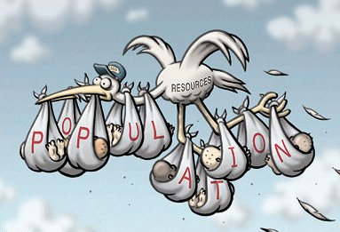
Unit 2: Population and Migration
Notes:
Activity: Population Party

Slide 3
Understanding where and how people live is essential to understanding global cultural, political, and economic patterns.

Slide 4
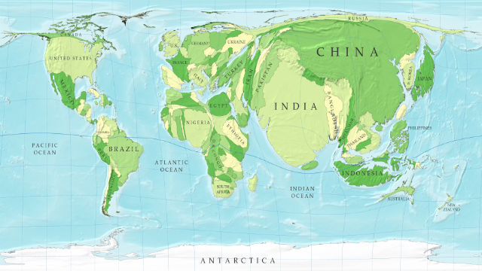
Population Concentrations
Notes:
60% of the world’s population lives within 60 miles of the ocean.
Population concentrates in areas with high soil arability/fertility, which also tends to have mild climates.
Population is becoming more urban.
Currently a little over half of the global population is urban with much higher rates in highly developed regions.

Slide 5
Distribution of Human Populations
Factors that explain patterns of population distribution vary according to the scale of analysis. What is scale?
Physical factors - climate, landforms, water bodies
Human factors - cultural, economic, historical, political
Why are some land areas not part of the ecumene?
Notes:
Ecumene: portion of the Earth’s surface occupied by permanent human settlement
Dry lands - desert, good for pastoralism and natural resources (petroleum)
Wetlands - located near equator, depletion of soil nutrients
Cold lands - land near North and South poles, permafrost
Highlands - exception is mountains near equator where agriculture is possible at high elevations
Where were the first civilizations? What are some examples of the human factors affecting population patterns? (imperialism and colonization exports, Republican vs. Democrat, racial areas)

Slide 6
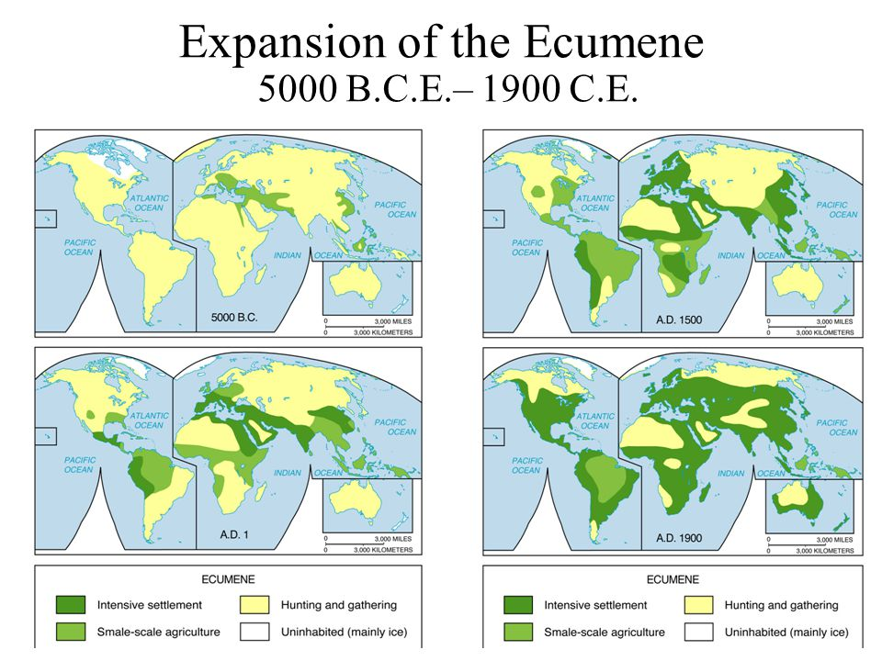

Slide 7
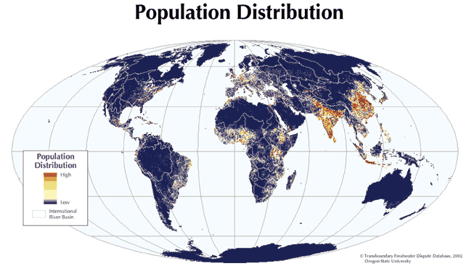
Four Clusters
East Asia, South Asia, Europe, Southeast Asia, Others
Notes:
Assign LiveBinder activity “Mapping World Population Distributions” with questions and chart

Slide 8
Population Density
Arithmetic Density:
Total number of objects in an area.
Total number of people divided by total land area
Divide population by the land area
Physiological Density:
Number of people supported by a unit area of arable land
Arable land: land suited for farming.
More meaningful than arithmetic density.
Agricultural Density:
Ratio of number of farmers to the amount of arable land
Helps account for economic differences
Developed countries = lower agricultural densities
Notes:
Arithmetic density does not take into account the physiographic differences in that area.

Slide 9
Country | Arithmetic Density | Physiological Density | Agricultural Density
Canada | 4 | 83 | 1
United States | 35 | 199 | 3
Netherlands | 498 | 1610 | 26
Egypt | 87 | 3011 | 273
Comparing physiological and arithmetic densities helps geographers understand the capacity of the land to yield enough food for the needs of the people.
What does the difference between the arithmetic and physiological densities suggest about Egypt?
The physiological densities are high in both Egypt and the Netherlands, but what accounts for the much lower agricultural density in the Netherlands?
Notes:
Egypt: most of the land isn’t suitable for agriculture (95% of people live along Nile and delta)
The Netherlands are more developed than Egypt and while they both put a lot of pressure on the land to produce food, the more efficient Dutch agricultural system requires fewer farmers than does the Egyptian system.
Arithmetic Density = Total People / Land Area
Physiological Density = Total People / Arable Land
Based on the physiological density, which two countries must stretch their food production the furthest? (Netherlands and Egypt)
Agricultural Density = Number of Farmers / Arable Land
Countries with high agricultural densities tend to be less economically developed (a larger number of people rely on subsistence farming) and vise-versa. More developed countries require less farmers per farm due to new agricultural technologies, less labor is needed.

Slide 10
Implications of Distribution and Densities
Influence political, economic, and social processes (redistricting, provision of services such as medical care)
Impact the environment and natural resources
Carrying capacity: the number of people, other living organisms, or crops that a region can support without environmental degradation.
Affect the need for infrastructure (housing) and urban services (sanitation)
Notes:
60% of the world’s population lives within 60 miles of the ocean.
Population concentrates in areas with high soil arability/fertility, which also tends to have mild climates.
Population is becoming more urban.

Slide 11
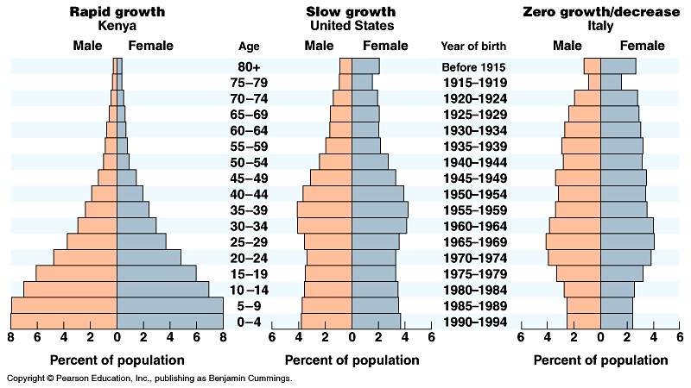
Population Pyramids
Age, sex, and ethnicity are all things that can be graphed and/or mapped to analyze population composition.
Population pyramids
are used to project
population growth and
decline and to predict
markets for goods and
services.
Notes:
Assign: Population Pyramid of Our School
Assign: GeoInquiries
Assign Kuby 5.2
Assign Power of the Pyramids (CD)
Do Kuby 5.1 as a class on quizziz
Assign: Population Pyramid Game
Population pyramids also called age-sex pyramids.
They generally come in four different shapes: rapid growth (wide base), stability (rectangular shape, mostly in developed countries), decline (base is smaller than previous cohorts), disrupted growth (gaps in pyramid usually result of war, antinatalist policies, etc.)

Slide 12
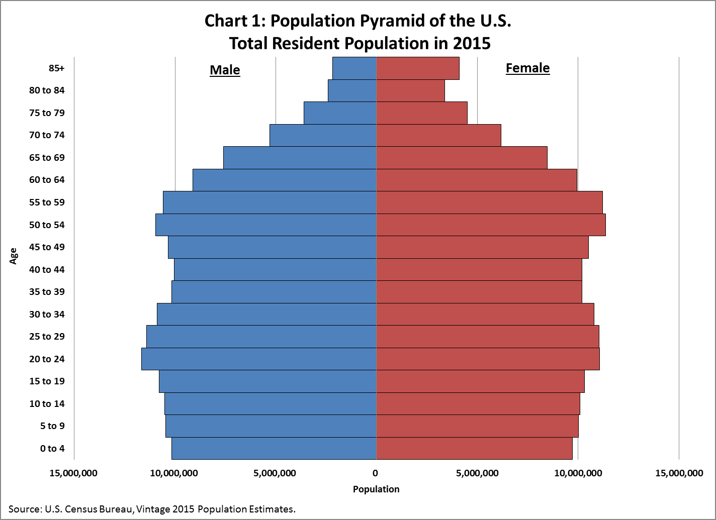
Population Pyramid: US
Notes:
Baby Boomers: consist of individuals born post WWII (1946-1964). They are the largest population cohort in United States demographic history. As this large generation of individuals enters retirement, the burden is increasingly falling on the economically productive members of the country.
Following the Baby Boom, the Baby Bust was a period of time during the 1960 and 70s when fertility rates in the US dropped. The drop is attributed to large numbers of women from the Baby Boom generation who sought higher levels of education and more competitive jobs, causing them to marry later in life, causing them to have fewer children than previous generations. (Children of the Corn, Rosemary’s Baby, etc.)

Slide 13
Changes in population are due to mortality, fertility, and migration, which are influenced by the interplay of environmental, economic, cultural, and political factors.

Slide 15
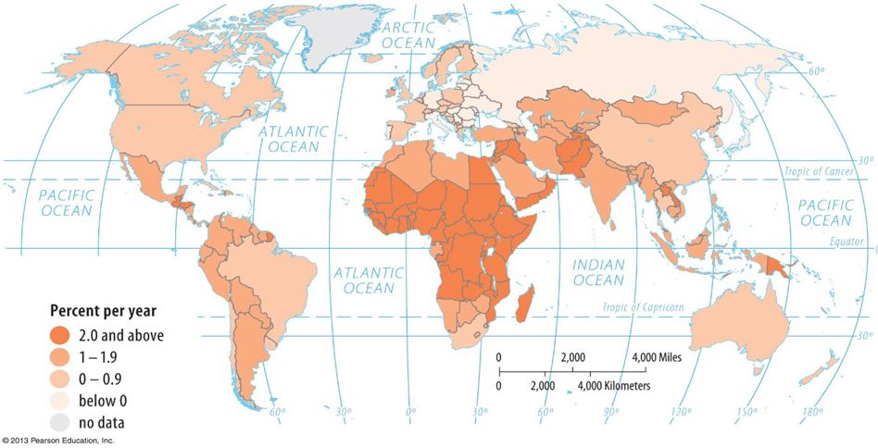
Population Growth and Decline
What factors contribute to population growth? Decline?
How do we explain population growth and decline?
Natural Increase Rate (NIR): percentage by which a population grows in a year.
Doubling time: number of years needed to double a population, assuming a constant rate of natural increase.
Notes:
Fertility, mortality, migration
NIR excludes migration, population is growing by 1.2% each year
Doubling Time: 1.1%/year, population would double in about 54 years
Where’s the highest NIR? Lowest?

Slide 16
Population Growth and Decline
Crude Birth Rate (CBR): total number of live births in a year for every 1000 people alive in the society.
Crude Death Rate (CDR): total number of deaths in a year for every 1000 population
Total Fertility Rate (TFR): average number of children a woman will have throughout her childbearing years
These are all affected by social, cultural, political, and economic factors.
Notes:
Sub-saharan Africa = CBR 40+, European = 10-
There are less extremes when analyzing CDR and it depends on the demographic transition model. Tell students to look at the maps in the book.
Assign GeoInquiries lesson.
Quiz over Chapter 2, allow to use notes.

Slide 17
Notes:
Assign: LiveBinder Demographic Transition Model Activity

Slide 18
Demographic Transition Model
Notes:
Assign: DTM: Sweden and Mexico, Data Chart
Assign: Making Connections

Slide 19
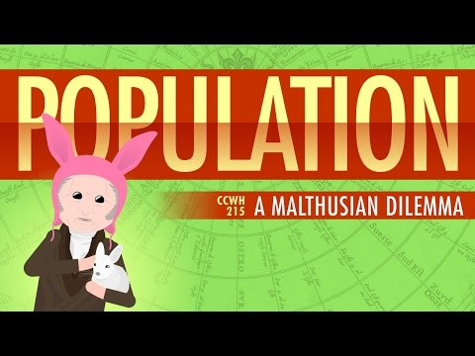
Notes:
Ask students what they think the next war will be fought over.

Slide 20
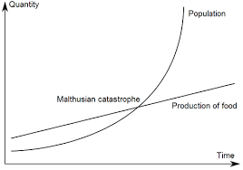
An Essay on the Principle of Population (1798)
Malthusian theory is used to analyze population change and its consequences.
Thomas Malthus claimed that the population was growing much more rapidly than Earth’s food supply because population increased geometrically and food supply increases arithmetically.
Notes:
In essence, population would grow more rapidly than the food supply. (1:1, 2:2, 4:3, etc.)
Assign: Malthus Article Debate

Slide 21
Malthusian Theory Debate
Some argue that Malthus was right, and that population is depleting key resources. Others do not accept this view.
Food production has increased more rapidly than predicted because of better techniques, higher-yielding seeds, and land cultivation. There are other resources to replace depleted ones.
But what happens when there are no more breakthroughs? And what about resources other than food?
Notes:
Water, energy

Slide 22
ZPG - Zero Population Growth

Slide 23
Malthusian Theory Debate
Population has increased much more slowly than Malthus had predicted. It has also increased more slowly than the food supply.
Population growth stimulates economic growth.
When does it become about inequality?
Notes:
Population growth = more consumers = more demand for goods = more jobs = more brains
The world possesses sufficient resources to eliminate hunger and poverty, if only these resources are shared equally.

Slide 24
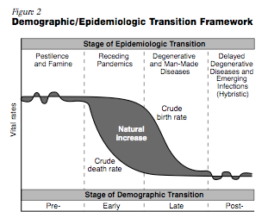
The Epidemiologic Transition
The epidemiologic transition explains causes of changing death rates in the demographic transition model.
Notes:
Epidemiology: the branch of medical science concerned with the incidence, distribution and control of diseases that are prevalent among a population at a particular time and are produced by some special causes not generally present in the affected place.
Stage 1: Illnesses and disease, war and murder, animal attacks = “natural checks” = Black Death, Bubonic Plague
Stage 2: improved sanitation, nutrition, and medicine during Industrial Revolution *precursor to GIS was used to track down cholera in Soho, a neighborhood in London
Stage 3: chronic disorders associated with aging, cardiovascular disease and cancer
Stage 4: bypasses and removal and treatment of cancer help people live longer, along with better diets and exercising, obesity is a major problem
Possible Stage 5 Causes:
Evolution - antibiotics and genetic engineering contribute to emergence of new strains, EX. Malaria was almost wiped out until DDT resistant mosquitoes were born
Poverty - infectious diseases are most prevalent in poor areas because of unsanitary conditions and inability to afford treatment, EX. tuberculosis
Connections - travel (relocation diffusion), EX. AIDS, Ebola
Play: https://www.learn4good.com/games/high-school-students-games/science-health.htm Pandemic Game
Assign: Chart

Slide 25
Changes in population have long- and short-term effects on a place’s economy, culture, and politics.

Slide 26
Population Policies
Pronatalism: policies that encourage reproduction
EX: France
Antinatalism: policies that discourage reproduction
EX: China and Singapore
Notes:
Assign China articles.
Many areas of Europe have a low fertility rate because of the following reasons:
education - people are more aware of the availability of contraception and consequences an unplanned pregnancy can have on their career
women in careers - Women may choose to follow their career choice rather than start a family while young
later marriages
state benefits - couples no longer need children to help care for them when older
France was a country with concerns that professional women were choosing not to have children. The government were worried that the population was not going to replace itself over time.
The policies that were put in place to encourage three-children families were:
a cash incentive of £675 monthly (nearly the minimum wage) for a mother to stay off work for one year following the birth of her third child
the 'carte famille nombreuse' (large family card), giving large reductions on train fares
income tax based on the more children the less tax to pay
three years paid parental leave, which can be used by mothers or fathers
government subsidised daycare for children under the age of three, and full time school places for over threes paid for by the government
This has resulted in mothers considering having children and remaining in work. The fertility rate in France is one of Europe's highest.
Like China, Singapore had a high birth rate and fertility rate.
The government introduced an anti-natal policy to try to reduce this. It did this by:
Making contraceptives available at a low cost.
Creating family planning clinics to help make advice more available.
Publicising through the media the advantages of having a smaller family.
Introducing financial incentives for smaller families (such as free education and health care benefits). The financial support stopped with larger families.
The impact of the policy:
The fertility rate has dropped to 1.2 in 2011.
There were insufficient workers to fill job vacancies because of the decrease in the birth rate.
Singapore has an ageing population.
The change in the birth rate was more dramatic because it was also caused by the increasing development of Singapore, meaning that more women followed careers rather than starting a family. This meant the birth rate fell because of factors not directly because of the policy.

Slide 27
India’s Deadly Secret: Gendercide in India

Slide 28
Reasons for Changes in Fertility Rates
After high school, what are your plans?
Notes:
Changing social values and access to education, employment, healthcare, and contraception have reduced fertility rates in most parts of the world.
Changing social, economic, and political roles for women have influenced the patterns of fertility, mortality, and migration.

Slide 29
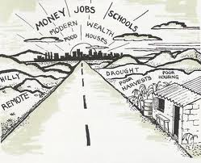
Ravenstein’s Laws of Migration
Short Distances
Urban Areas
Multiple Steps
Rural to Urban
Counter Migration
Youth
Gender Patterns
Notes:
Most migrants travel only a short distance.
Migrants traveling long distances usually settle in urban areas.
Migrants reach their eventual destination through a series of smaller moves.
Most migration in history has been from rural to urban areas.
Each migration flow produces a movement in the opposite direction.
Most migrants are young adults.
Most international migrants are young males, while more internal migrants are female.

Slide 30
Causes of Immigration
Push Factors:
Perceived as negative.
Poor economic conditions
warfare
Pull Factors:
Perceived as positive.
Better quality of life
Economic opportunity
Cultural: religious freedom
Demographic: unbalanced sex ratios, overpopulation
Economic: job availability, “land of plenty”
Environmental: natural disasters, pulled to physically beautiful locations
Political: persecution, conflict (civil war)
Notes:
Assign: Way Up North (NY Times Immigration)
Note: Rubric and examples on Day 1, Unit 2.
Play: CYOA or Murder Mystery

Slide 31
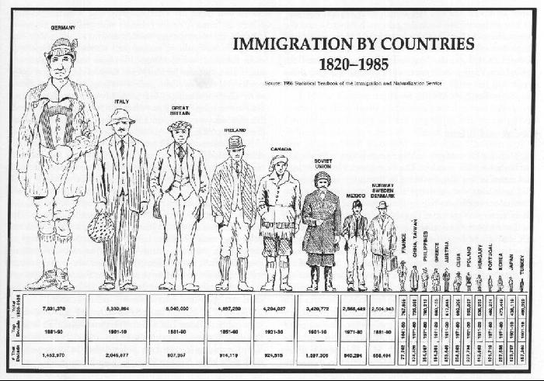
US Immigration
Peaks in immigration to the United States reflect changing circumstances on a global scale.
Notes:
The most significant internal migration movements in the United States can be characterized in three waves:
Wave 1: beginning with colonization, a movement of the population westward and movement from rural to urban areas as places become increasingly industrialized.
Wave 2: from the early 1940s through the 1970s a massive movement of African Americans from the rural south to cities in the South, North, and West.
Wave 3: post-WWII to the present day movement to the sun belt states (15 states from North Carolina to Southern California and all the states south of that line).
Assign: Migration Table and Case Study

Slide 32
Forced Migration
Refugees: individual who was forced to migrate to another country to avoid the effects of armed conflict, situations of generalized violence, violations of human rights, or other disasters and cannot return for fear of persecution for race, religion, nationality, membership of a social group, or political opinion
Internally Displaced Persons: forced to migrate like a refugee, but didn’t migrate across an international border
Asylum Seekers: someone who has migrated to another nation in hopes of becoming a refugee

Slide 33
Voluntary Migrations
Transnational migration is a process of movement and settlement across international borders in which individuals maintain or build multiple networks of connection to their country of origin while at the same time settling in a new country.
Transhumance: seasonal herding of animals from higher elevations in the summer to lower elevations and valleys in the winter.
Guest Worker: Circular or temporary labor migration that aims to add workers temporarily to a country’s labor force

Slide 34
Voluntary Migrations
Internal migration is a permanent move within a country. It is split into:
Interregional migration: movement from one region of a country to another (Northeast to South)
Intraregional migration: movement within a region of a country (rural to urban)

Slide 35
Voluntary Migrations
Chain migration: the migration of people to a specific location because relatives or members of the same nationality previously migrated there.
Step migration: series of shorter, less extreme migrations from a person's place of origin to final destination—such as moving from a farm, to a village, to a town, and finally to a city.
And then there is rural to urban, urban to suburban, and urban to rural.
Notes:
Chain migration (Asia example - Chinatown)
Rural to urban - Industrial Revolution, economic advancement
Urban to suburban - lifestyle
Urban to rural - counterurbanization, lifestyle

Slide 36
Obstacles to Migration
Distance: long, arduous, and expensive
Intervening Obstacles: an environmental or political feature that hinders migration
Transportation improvements that have promoted globalization, such as motor vehicles and planes, have diminished the importance of intervening obstacles.
What are some other obstacles to migration?
Notes:
Religion, bureaucracy, lack of money, language, national policy
Government policies worksheet
Intervening opportunities: presence of a nearer opportunity that greatly diminishes the attractiveness of sites farther away

Slide 37
Consequences of Migration
What are some of the consequences
Positives:
of migration?
Negatives:
Notes:
GeoInquiries
Case-Study: US and Mexico Border
Consequences of Migration

Slide 38
An Aging Population
Population aging is influenced by birth and death rates and life expectancy.
Fewer people are being born, less people are dying, and people are living longer.

Slide 39
Implications of an Aging Population
Social: changing roles of elders/children, need for/growth of services for Elderly, development of pronatalist policies, social conflict due to generational differences of opinions
Economic: increased cost to society due to government programs/taxes, increased economic pressure on the labor force (dependency ratio)
Political: increased gray power, development of pronatalist policies
Notes:
Who will support your parents in the future? How long do you expect your parents to support you?
Geriatric medical/social services and facilities
Elderly may resist societal changes desired by young, elders resented for requiring excessive human/capital resources
Medical care, housing, accessibility, pensions
Challenges sustaining the economy, fewer people working, fewer people paying taxes
Seniors with more political/personal influence, social and political action on behalf of elderly
Need to sustain population
Assign LiveBinder Analysis of a Country
Assign: FRQ 2013, #2 - partner, read examples, assign scores, and discuss.

