Slide 1
Cultural Patterns and Processes

Slide 2
Big Ideas
Patterns and Spatial Organization (PSO)
How does where people live and what resources they have access to impact their cultural practices
Impacts and Interactions (IMP)
How does the interaction of people contribute to the spread of cultural practices?
Spatial Patterns and Societal Changes (SPS)
How and why do cultural ideas, practices, and innovations change or disappear over time?

Slide 3
Topic 3.3 Cultural Patterns

Slide 4
Enduring Understanding: PSO-3
Cultural practices vary across geographic locations because of physical geography and available resources

Slide 5
Learning Objective: PSO-3.D
Explain patterns and landscapes of language, religion, ethnicity, and gender

Slide 6
Essential Knowledge PSO-3.D.1
Regional patterns of language, religion, and ethnicity contribute to a sense of place, enhance placemaking, and shape the global cultural landscape
Language: is a set of mutually intelligible sounds and symbols that are used for communication
Speakers of the language use it to communicate
Language is an important part of culture
Reflects and shapes the culture
Shared language makes people of a culture visible to one another and the world
Language tells a lot about the culture and what values and ways of life not only now but also in the past
Standardized Language
Language is dynamic, and with technological advances societies are more likely to have a standard language
One that is published, widely used, and taught

Slide 7
Essential Knowledge PSO-3.D.1
Regional patterns of language, religion, and ethnicity contribute to a sense of place, enhance placemaking, and shape the global cultural landscape
Dialects within a language
Variants of a standard language along regional or ethnic lines is called a dialect
What makes up a dialect
Difference in vocabulary
Syntax (the way words are put together to form phrases)
Pronunciation
Cadence (rhythm of speech)
Even the pace of speech
Even have different words for same thing: Pop, Soda, Coke

Slide 8
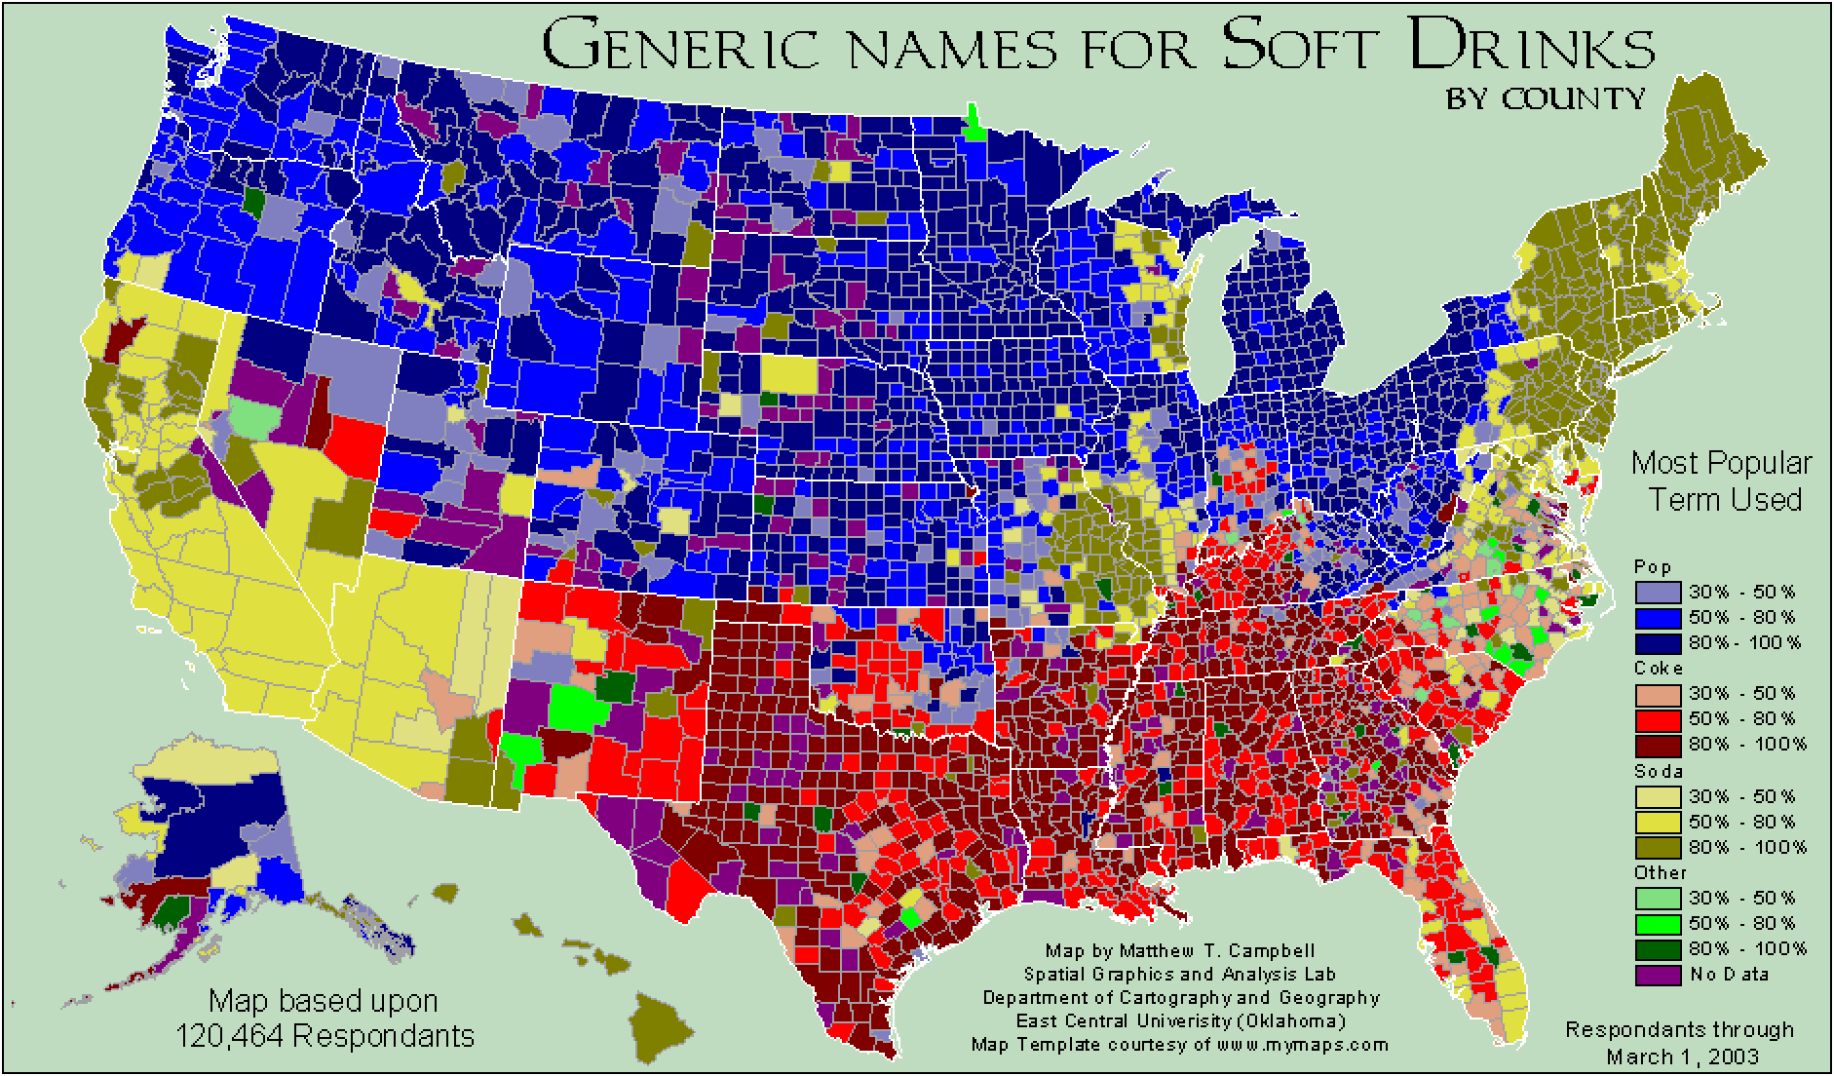

Slide 9
Essential Knowledge PSO-3.D.1
Regional patterns of language, religion, and ethnicity contribute to a sense of place, enhance placemaking, and shape the global cultural landscape
Languages in use today
Most linguists and linguistic geographers today recognize between 5,000 and 6,000 languages
More than 600 in India and 1,000 in Africa
We will get to why this can be problematic in next section and how states attempt to fix that problem
Religion – divided into two major groups – universalizing and ethnic
Universalizing seeks converts; ethnic you are born into and does not actively seek people to covert
Religion plays a key role in a place’s identity and the cultural landscape

Slide 10
Essential Knowledge PSO-3.D.1
Regional patterns of language, religion, and ethnicity contribute to a sense of place, enhance placemaking, and shape the global cultural landscape
Sense of Place – state of mind derived through the infusion of a place with meaning and emotion by remembering important events that occurred in that place or by labeling a place with a certain characteristic
A big part of sense of place and the infused meaning and emotion of that place is tied to ethnicity, language, and religion
If they speak a language you know, practice a religion you do, or you have a common connection you will look at that place favorably
The opposite is true as well
Sense of place is relative to each individual involved
A positive or negative view of a place is for that particular person (or group)and does not always extend to others

Slide 11
Essential Knowledge PSO-3.D.1
Regional patterns of language, religion, and ethnicity contribute to a sense of place, enhance placemaking, and shape the global cultural landscape
Placemaking
How people alter the landscape around them to reflect their culture and ethnicity
Great example of placemaking is ethnic neighborhoods
This is taking an existing place, altering the landscape to better reflect their culture and values
The act of placemaking to create an environment that has a positive sense of place for that particular ethnic or cultural group has a tremendous impact on the cultural landscape
Everything we see around us in the world is about creating a place that reflects what that area cares about and and believes in.

Slide 12
Both images San Francisco Street –
Highlighting sense of place and placemaking by language & ethnicity

Slide 13
What makes these two building different? How can we tell
Sense of Place & Placemaking on display by a single image

Slide 14
Essential Knowledge PSO-3.D.2
Language, ethnicity, and religion are factors in creating centripetal and centrifugal force
Centripetal Force – Force that unites
Centrifugal force – Forces that divide
States, regions, cities, groups all have to balance centripetal and centrifugal forces
Language can both bind or separate
If 2 groups speak the same language and can communicate it can bring them together, if two groups cannot speak it pulls them apart
Language fragmentation with a state or region can have tremendous consequences
We will look at this with a map of language in Africa at different scales

Slide 16
Essential Knowledge PSO-3.D.2
Language, ethnicity, and religion are factors in creating centripetal and centrifugal force
Within Africa there are 6 major language families
However, most of these language families have sub families that speak an entirely different language
If we look at Nigeria we can see this fragmentation
This can cause tremendous amount of conflict and problems within a state (a major centrifugal force)
To combat this they have everybody learn English to fight centrifugal force, turning the language of English into a centripetal force

Slide 17
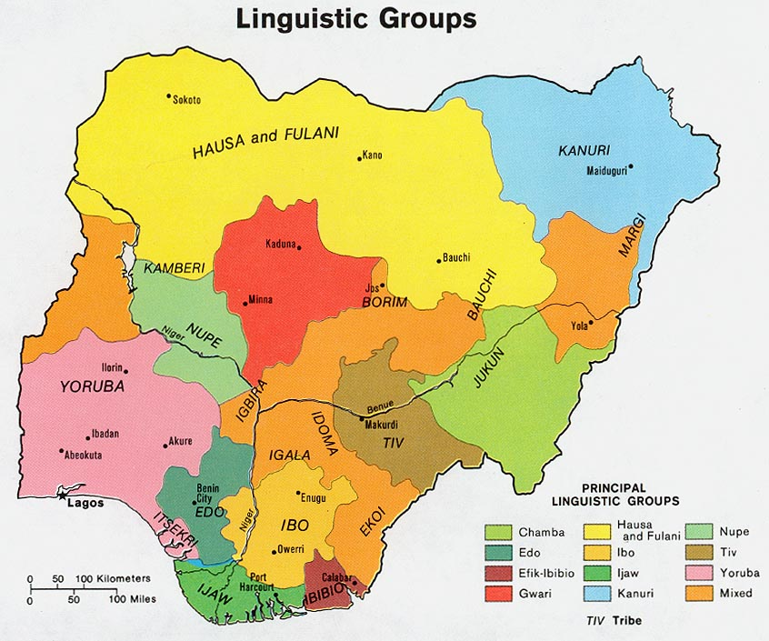

Slide 18
Essential Knowledge PSO-3.D.2
Language, ethnicity, and religion are factors in creating centripetal and centrifugal force
Centripetal Force – Force that unites
Centrifugal force – Forces that divide
States, regions, cities, groups all have to balance centripetal and centrifugal forces
Ethnicity
Much like language ethnicity can be a centripetal or centrifugal force
Traditional if all one ethnicity is within an area it unites; more than one ethnicity it can divide
Ethnic conflicts have caused sprung up around the world and continue to this day to be a problem (we will have an activity on this)

Slide 19
Essential Knowledge PSO-3.D.2
Language, ethnicity, and religion are factors in creating centripetal and centrifugal force
Centripetal Force – Force that unites
Centrifugal force – Forces that divide
States, regions, cities, groups all have to balance centripetal and centrifugal forces
Religion
Religion can both unify and divide a state/region
If one religion is practiced and routinely followed by many people it can tend to be a centripetal force
However, if we look back at the ethnic conflict activity we will see that many of them are driven by religion
Holy Sites for religion are also very important
However a place like Jerusalem which is a holy site for 3 religions (2 of which having the most adherents) can have a tremendous amount of conflict
You will continue to see and hear examples of centripetal and centrifugal forces

