Slide 1
World War I
Domestic life was greatly affected as the U.S. helped the Allies achieve victory in World War I. The Treaty of Versailles punished Germany, but was never ratified by the U.S. Senate.

Slide 2
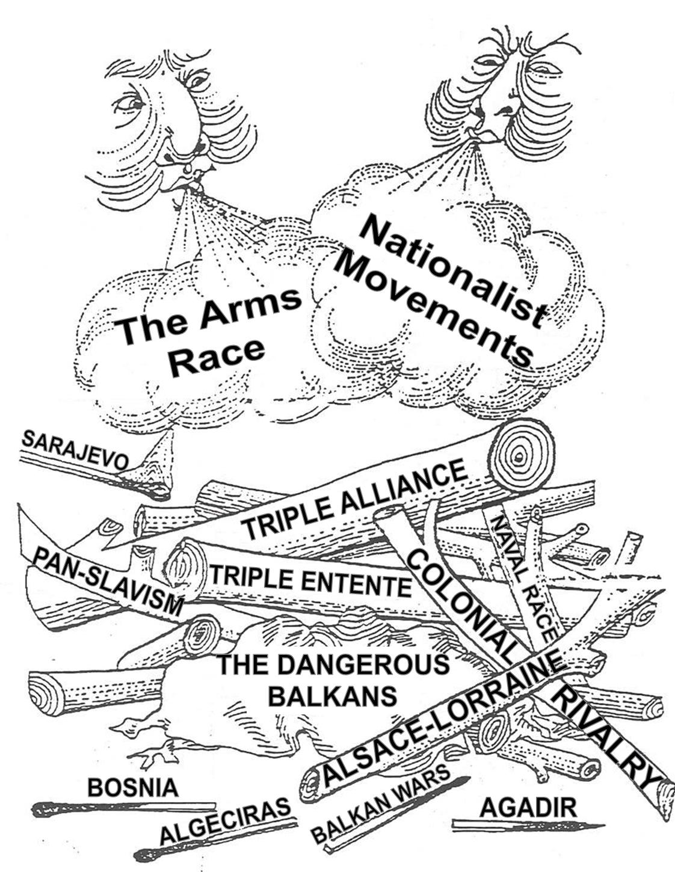
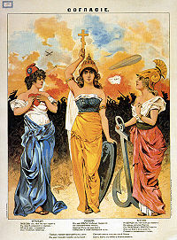
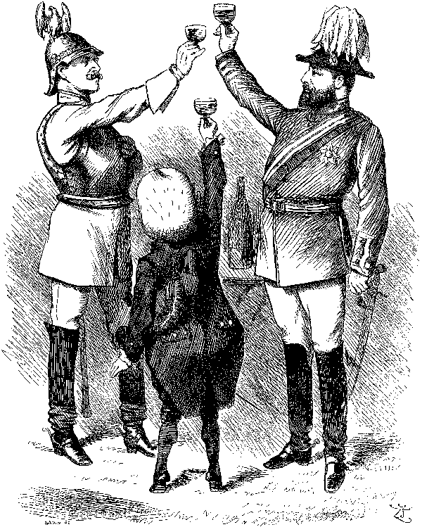
Causes of World War I
Nationalism - devotion to one’s nation
• leads to competition, antagonism
• Many fear Germany
• ethnic groups want independence
• Russia sees self as protector of all Slavic peoples

Slide 3
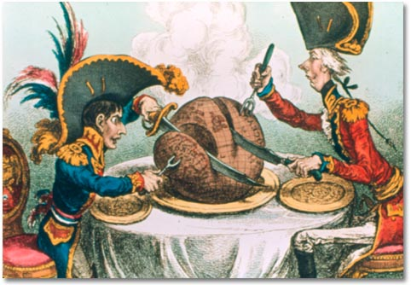
Causes of World War I
Imperialism
• Germany industrializes, competes with France, Britain for colonies
Militarism—development of armed forces, their use in diplomacy
• defending empires leads to more military spending
• By 1890, Germany has strongest army on European continent
- competes with Britain for sea power
- leads other powers to join naval arms race

Slide 4
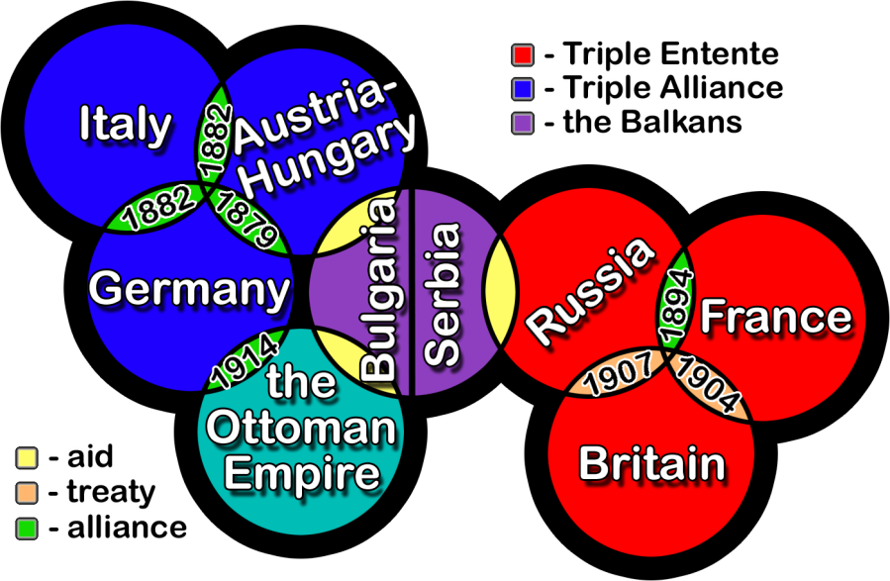
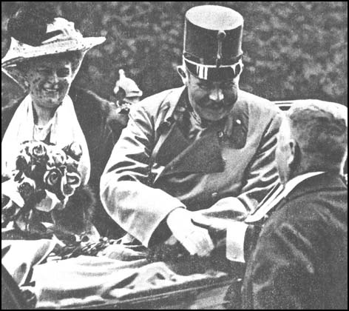
Causes of World War I
Alliance System
• Triple Entente or Allied Powers
—France, Britain, Russia
• Triple Alliance or Central Powers
- Germany, Austria-Hungary,Ottoman Empire
• give security; nations unwilling to tip balance of power
Alliances Complicate Conflict
• Balkan Peninsula known as “the powder keg of Europe” because:
- ethnic rivalries among Balkan peoples
- leading powers have economic, political interests
• Archduke Franz Ferdinand of Austria shot by Serbian nationalist
• Austria-Hungary declares war on Serbia, expects short war – NOT!

Slide 5
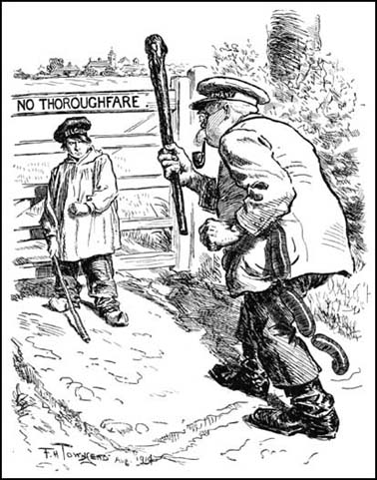
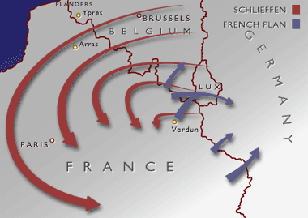
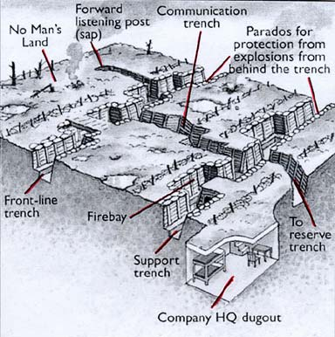
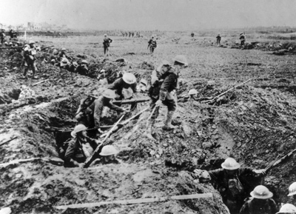
The Fighting Starts
• Schlieffen Plan: hold Russia, defeat France, then Russia
• German troops sweep through Belgium
• By spring 1915, trenches cross France
• “No man’s land”—barren expanse of mud between opposing trenches
• Scale of killing horrific, fighting inconclusive – gain yards only

Slide 6
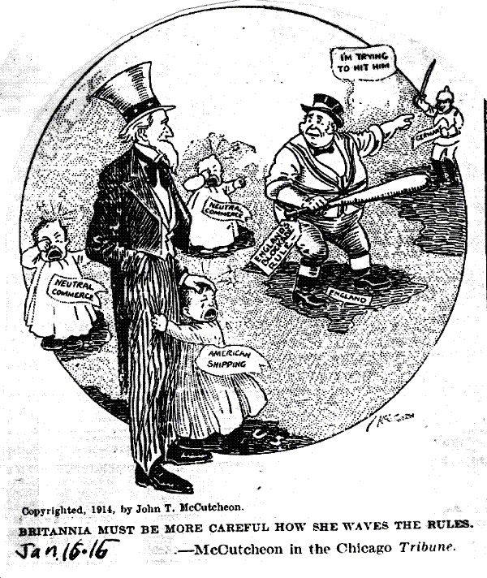
Americans Question Neutrality
Divided Loyalties
• Socialists, pacifists, many ordinary people against U.S. in war
• Naturalized citizens concerned about effect on country of birth
• Many feel ties to British ancestry, language, democracy, legal system
The U.S. Prepares
• By 1917, mobilized against Central Powers to:
- ensure Allied repayment of debts
- prevent Germans threat to U.S. shipping

Slide 7
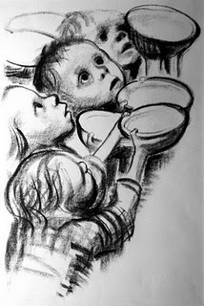
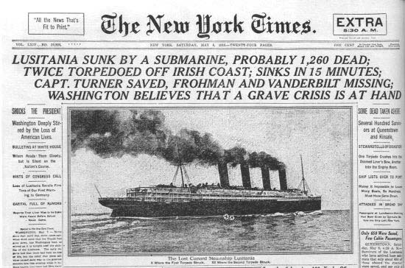
The War Hits Home
The British Blockade
• North Sea, stop supplies to Germany
• U. S. ships seldom reach Germany
• Germany has difficulty importing food, fertilizer; by 1917, famine
German U-Boat Response
• U-boat counterblockade
• Lusitania; 128 Americans among the dead
-U.S. public opinion turns against Germany
• Wilson protests, Germany continues
- asks US to end food blockade by GB

Slide 8
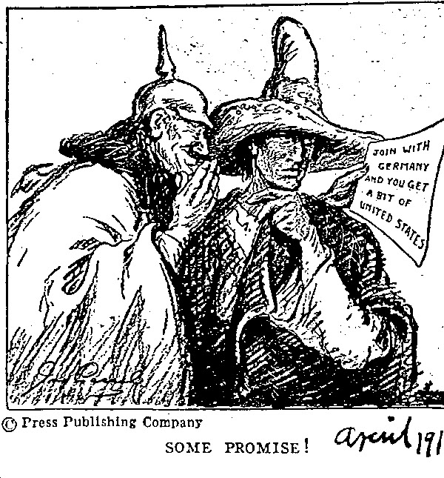
The United States Declares War
German Provocation
• Wilson tries to mediate, “a peace between equals”
• Zimmerman note— alliance of Germany, Mexico
• Russian monarchy replaced with representative government
- war of democracies against monarchies
America Acts
• war to make world “safe for democracy”

