Slide 1
The New Deal
How did President Franklin D. Roosevelt’s New Deal programs stimulate the economy and the arts?
How did the New Deal leave a lasting, yet controversial mark on American government?

Slide 2
A New Deal Fights the Depression
Electing Franklin Delano Roosevelt
• Democrats nominate NY governor Franklin Delano Roosevelt
- reform-minded; projects friendliness, confidence
• Democrats overwhelmingly win presidency, Senate, House
Waiting for Roosevelt to Take Over
• With “Brain Trust,” FDR formulates policies to alleviate problems
• New Deal—relief for needy, economic recovery, financial reform

Slide 3
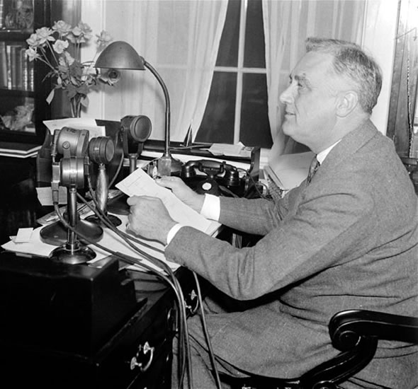
The Hundred Days
• FDR launches Hundred Days; passes over 15 major New Deal laws
• Emergency Banking Relief Act permits Treasury Dept. to inspect banks
- decides which are insolvent, sound, or need loans
- public confidence in banks revived
An Important Fireside Chat
• FDR gives fireside chats—radio talks explaining New Deal measures
• First chat discusses need for public support of government, banks

Slide 4
• Glass-Steagall Act establishes Federal Deposit Insurance Corporation
- insures individual bank accounts, regulates banking practices
• Federal Securities Act—companies must give all information on stocks
• Securities and Exchange Commission created to regulate stock market
• FDR gets law allowing production of some alcoholic beverages
• 21st Amendment repeals prohibition by end of 1933

Slide 5
Helping the American People
Rural Assistance
• Agricultural Adjustment Act (AAA) raises food prices, lowers supply
• Tennessee Valley Authority creates jobs renovating, building dams
Providing Work Projects
• Civilian Conservation Corps—public works jobs for young men
• Public Works Administration—money to states to create jobs
• Civil Works Administration builds rural schools, pays teachers

Slide 6
Promoting Fair Practices
• NIRA establishes codes of fair practice for industries
- creates National Recovery Administration (NRA)
• NRA sets standards, prices, limits production
Food, Clothing, and Shelter
• Home Owners Loan Corporation gives loans to prevent foreclosures
• Federal Housing Administration gives loans for mortgages, repairs
• Federal Emergency Relief Administration—direct relief to needy

Slide 7
The New Deal Comes Under Attack
Opposition to the New Deal
• Deficit spending—spending more money than government takes in
- funds New Deal
• Liberals: New Deal does not do enough to help poor, fix economy
• Conservatives: New Deal used to control business, socialize economy
The Supreme Court Reacts
• Supreme Court strikes down NIRA, AAA as unconstitutional
• FDR proposes “Court-packing bill”; Congress, press protest
• Starting in 1937, justices retire; FDR appoints seven new ones

Slide 8
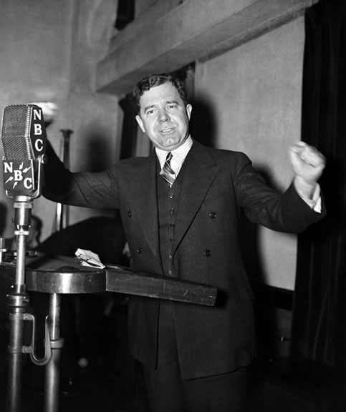
Three Fiery Critics
• Some conservative opponents form American Liberty League
• Think measures violate respect for personal rights, property
• Father Charles Coughlin withdraws initial support of New Deal
- wants guaranteed income, banks nationalized
• Dr. Francis Townsend devises pension plan for elderly
• Presidential hopeful, Senator Huey Long has popular social program

Slide 9
The Second New Deal Takes Hold
The Second Hundred Days
Furthering the New Deal
• By 1935, economic recovery not as great as FDR had expected
• FDR launches second phase: more relief for farmers, workers
• First Lady Eleanor Roosevelt, a social reformer, prods president
Reelecting FDR
• 1936, Democrats win presidency, large majorities in both houses
• First time most African Americans vote Democratic
• First time labor unions support presidential candidate

Slide 10
Helping Farmers
Focusing on Farms
• 1936 Soil Conservation and Domestic Allotment Act replaces AAA
- rewards farmers for practicing soil conservation
• New Agricultural Adjustment Act avoids unconstitutional provision
• Resettlement Administration gives loans to small farmers to buy land
• Farm Security Administration—loans to tenant farmers to buy land
• FSA hires photographers to shoot rural towns, farms, farmers

Slide 11
Roosevelt Extends Relief
Programs for Urban Workers
• Works Progress Administration (WPA)—creates jobs
• WPA workers build airports, roads, public buildings
• Women workers sew clothes for the needy
• WPA employs professional writers, artists, performers
• National Youth Administration (NYA)—education, jobs, counseling
• Gives aid to students in exchange for part-time work

Slide 12
Improving Labor and Other Reforms
Improving Labor Conditions
• National Labor Relations Act, or Wagner Act, replaces NIRA:
- protects right to join unions, collective bargaining
- prohibits unfair labor practices
• National Labor Relations Board hears testimony about labor practices
• Holds elections to determine if workers want unions
• Fair Labor Standards Act sets maximum hours, minimum wage

Slide 13
The Social Security Act
• 1935, Social Security Act creates Social Security system; provides:
- insurance for retirees 65 or older
- unemployment compensation
- aid to disabled, families with children
Expanding and Regulating Utilities
• Rural Electrification Administration brings electricity to farms
• Public Utility Holding Company Act aims to stop financial corruption

