Slide 1
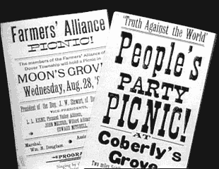
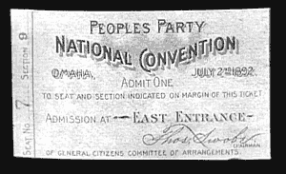
The Populist Movement

Slide 2
I.) Issues
A.) Money Issues:
Problem:
Civil War issue “Greenbacks”
(Greenbacks worth less than hard money)
Solution: Government takes them out of circulation!
Outcome:
1. Farmers lose land and cant buy more!
2. Money becomes a national issue

Slide 3
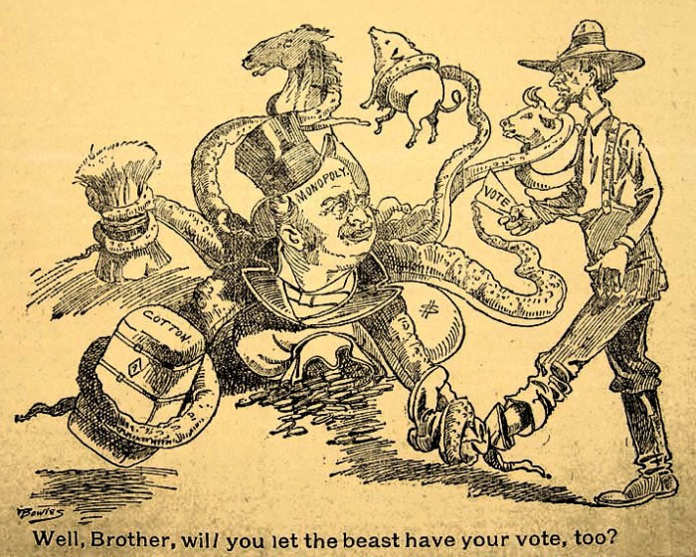
B. Issue with the Railroads
Cause:
1. Lack of competition for railroads
2. Secret agreements = railroads control grain prices
Effect:
1. Farmers pay high prices to transport goods
2. Farmers mortgage farms & pay high interest
Outcome:
1. Calls for Reform!

Slide 4
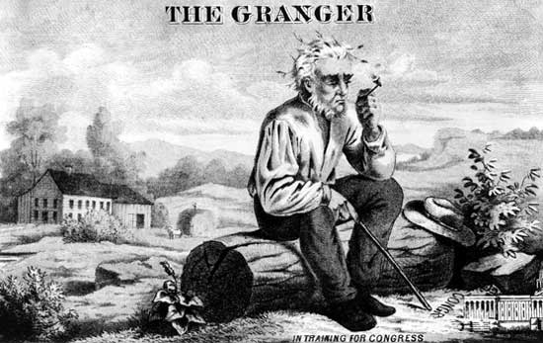
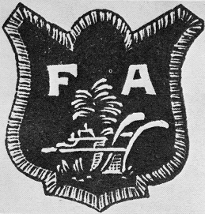
II.) Reform Movements
Granger Movement- organization of farmers to provide a social outlet & educational opportunities for farm families
B. Farmers’ Alliance- organization of farmers with the goals to:
- educate about lower interest rates
- urge govt. control of banks & railroads

Slide 5
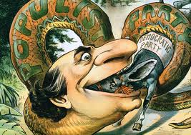
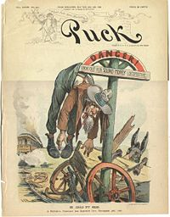
Populism- political movement seeking that people have a greater
say in govt. (advocated for farmers & workers)
Goals:
1. Economic reform:
-increase money supply
-graduated income tax
-federal loan program
2. Government reform:
-senators elected by popular vote
-single terms for president & vice
-secret ballot to end vote fraud
3. Social reform:
-eight hour work day
-restrictions on immigration

Slide 6
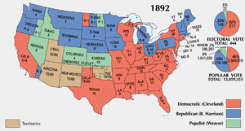
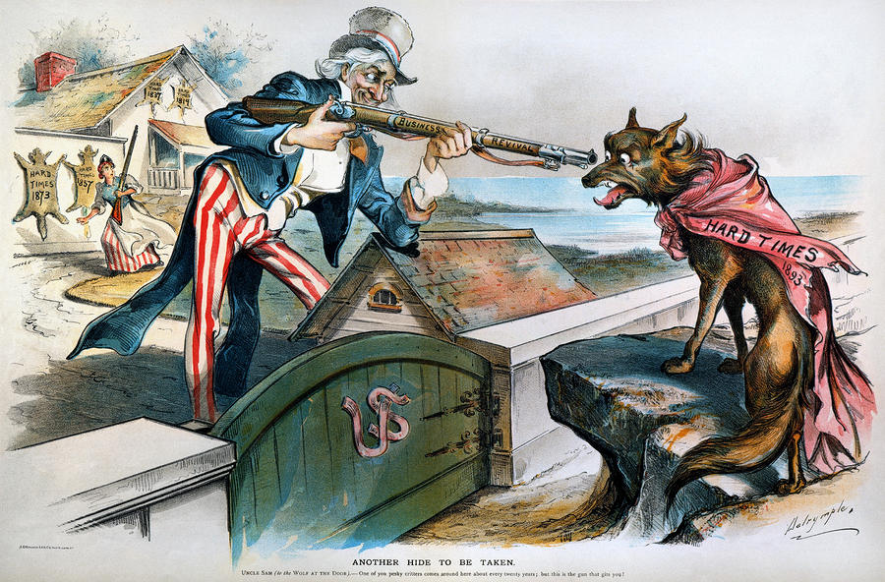
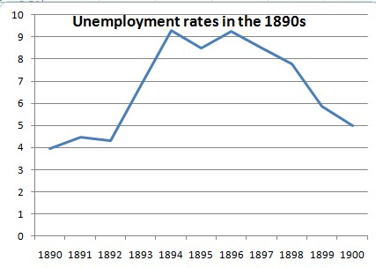
III.) The Populist Party & Issues
Election of 1892- Populist candidate
wins 10% of vote
B. Panic of 1893- economic recession
Cause: - Railroads go bankrupt
- Stock Market prices fall
- Trade of currency for gold
- Silver price falls
Effect: -15,000 businesses close
- 500 banks collapse
- wages, investments, prices fall
- 3 million lost jobs

Slide 7
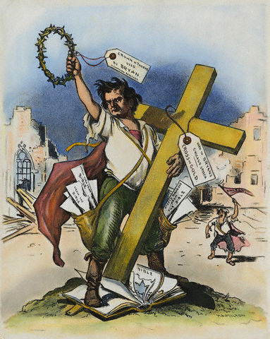
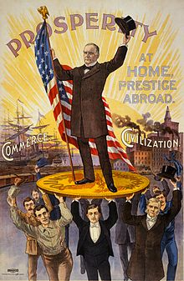
Question: Gold or Silver?
Vs.
1. Bimetallism- monetary system in which citizens get gold or silver in exchange for paper currency (Silverites)
2. Gold Standard- monetary system in which dollars are backed solely by gold (Gold Bugs)

Slide 8
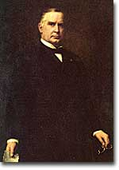
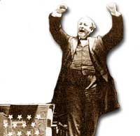
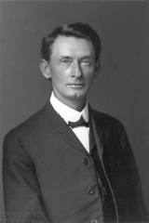
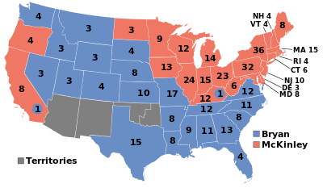
C. The Election of 1896-
Outcome: -McKinley wins election
- Populist Party collapses
Legacy: - People could Organize & make Reforms
- Big Business Rules!!!
Vs.
Vs.
Republican candidate William McKinley of Ohio (Gold Bug)
Democratic candidate William Jennings Bryan (Sliverite)
Populist candidate Thomas Watson

