Slide 1
International Political Geography

Slide 2
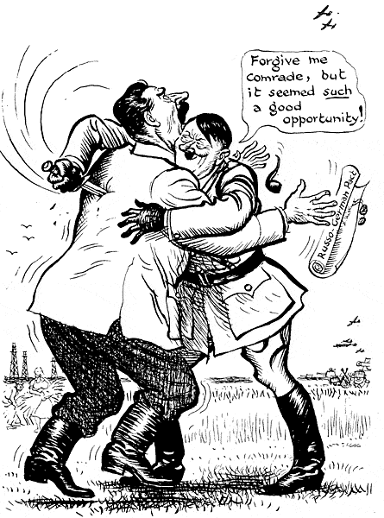
Early Theories
Organic Theory – Friedrich Ratzel – late 19th c German School
Turned into field of Geopolitics – nations must expand their land base in order to maintain vibrancy
Territory is the state’s essential, life giving force
Like organisms that fail to find food supplies, if they do not expand, they die
Discarded after WWII and Hitler used it to justify his theory of lebensraum “living space”

Slide 3
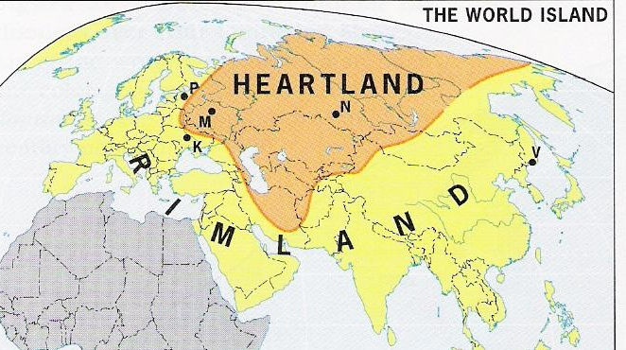
Heartland Theory – Sir Halford Mackinder – early 20th c British/American School
Geographical “pivot point” of all human history was in northern and central Asia
He who rules the heartland, rules the world
Offered suggestion in 1943 to prevent USSR from invading the “inner crescent” or Rimland
Contemporaries felt oceans provided avenue to conquest, not land
No historical evidence to support this area as hearth of conquest
Rimland Theory – Nicholas Spykman
Area around heartland was most important
Who rules East Europe
commands the Heartland
Who rules the Heartland
commands the World Island
Who rules the World Island commands the World

Slide 4
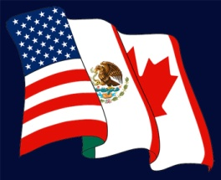
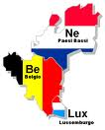
Current Trends – International Alliances
International Organizations - two or more countries seeking cooperation w/o giving up autonomy or self-determination
Global - UN
focused on peace and security
Presents powerful force with collective action (ie: economic sanctions)
Regional - NAFTA and Benelux (as well as: ACS, MERCOSUR, ECOWAS, APEC)
Links states economically to open borders and promote trade
Supranational Organizations – members give up some state sovereignty – over 60 created
OEEC→ECSC → EEC → EC → EU
Over dozen states, central admin center (Brussels, Belgium) and unified currency (euro)

Slide 5
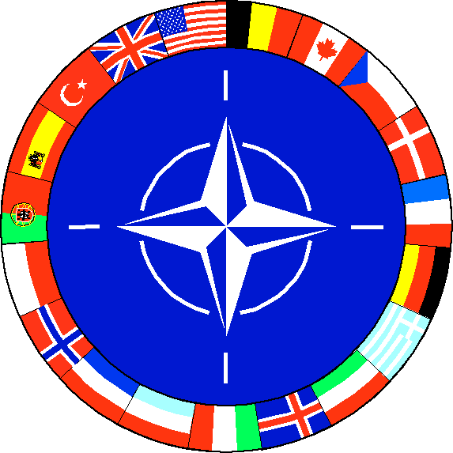
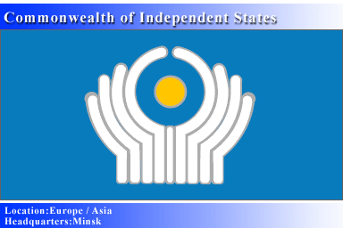
Economic Alliances – member countries have one single thing in common - OPEC
Military Alliances – join together for military purposes – NATO
allow other members to establish bases within territories
Confederations – CIS – former Soviet Union states – common economic and administrative needs
East/West Divide
Cold War era (communist/free market)
North/South Divide
vs. Post Cold War era (wealthy Europe and North America/poor Africa, Asia and Latin America)

Slide 6
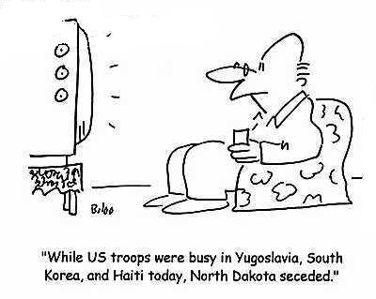
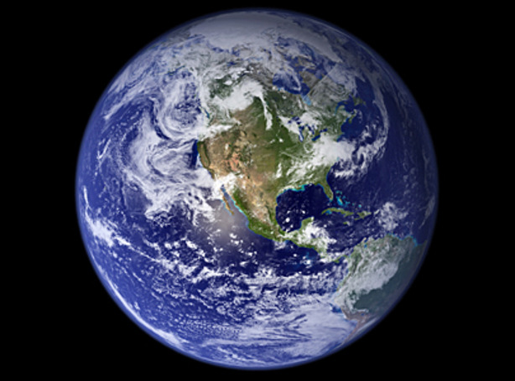
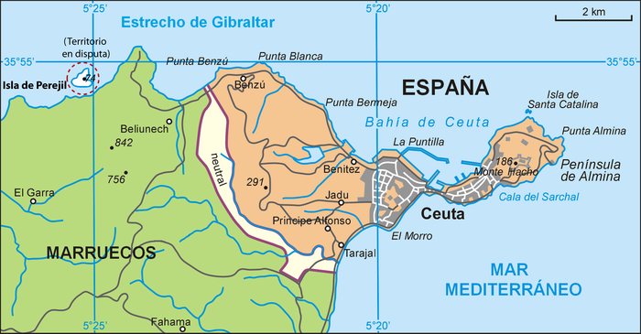
Spatial Conflict
Space ownership
historically a volatile issue
All scales
Local – areas seceding from city
National – conflict over island ownership (Spain and Morocco over Perejil)
Global – debate over regulation of environment

Slide 7
Terrorism
State missions to defeat extremists produce support in short term, but may weaken the state when they are unable to defeat extremists
Christian fundamentalist Timothy McVeigh, airplane bombing in Lockerbie, Scotland, World Trade Center bombing
Globalization creates geography that does not mirror state maps

