Slide 1
Agricultural Revolutions
There are 3

Slide 2
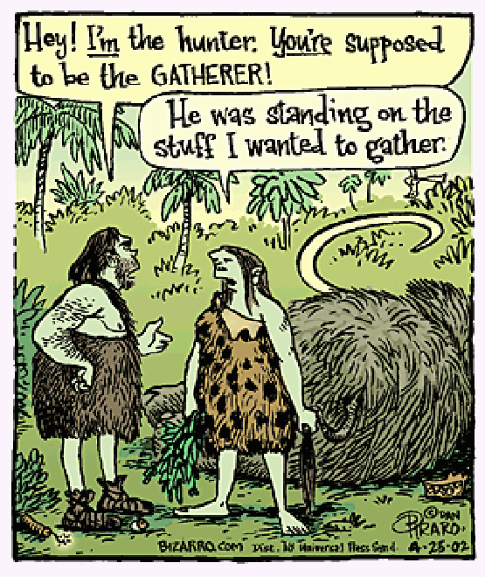
Before Agriculture
Nomadic
Hunting and Gathering Societies

Slide 3
Revolution?
A revolution is any fundamental change or reversal of conditions, a great and sometimes violent change or innovation
So, how does farming have a revolution?

Slide 4
Neolithic Revolution
The First
10,000 years ago (8000 BCE – 3500 BCE)
Humans begin to slowly domesticate plants and animals
Nomadic people became SEDENTARY

Slide 5
Neolithic Revolution
Advantages | Costs
Steady food supply | Dependent on certain crops failure = starvation
Greater Population | Disease from close contact with animals, humans & waste
Organized society = Civilization Specialization Religion Education | Cannot easily move

Slide 6
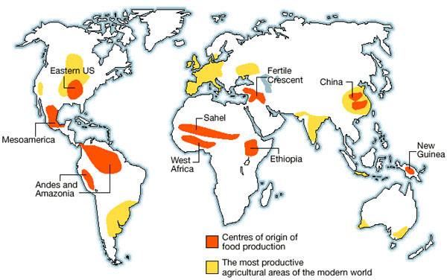
Agricultural Hearths

Slide 7
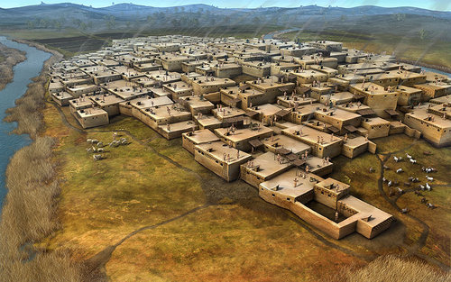
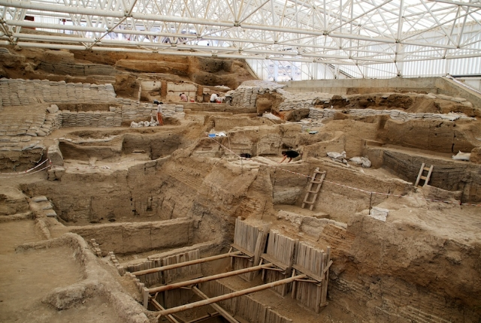
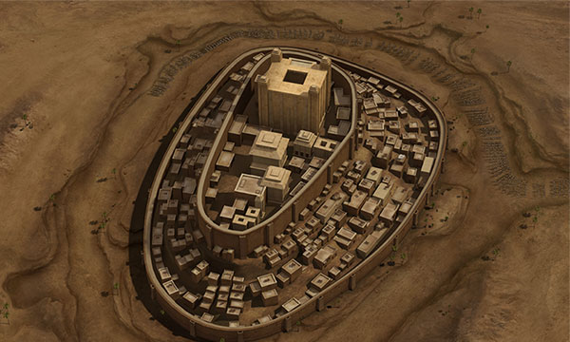
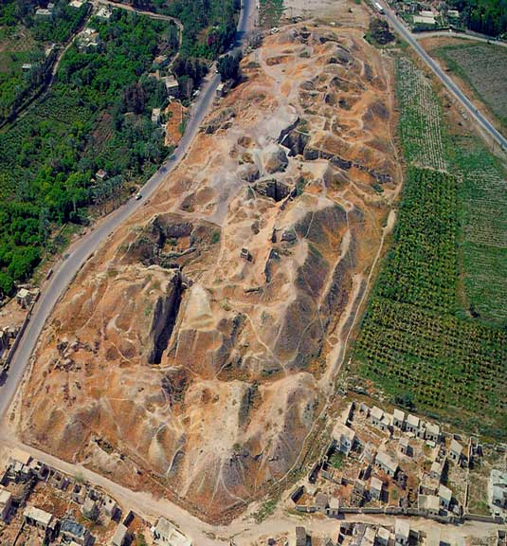
Settlements
First Towns Develop
Catal Huyuk (Turkey) 7000 bce
Jericho (Israel) 7000 bce

Slide 8
Open Field System
Medieval agriculture
1/3 – ½ of fields are fallow
Common land: used by village for livestock; fields shared by peasants
Serfs often lowest; many sold with land (slavery)

Slide 9
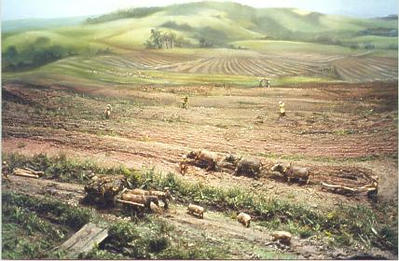
Disadvantages of the old system
People have to walk over your strips to reach theirs
Field left fallow
Difficult to take advantage of new farming techniques
No hedges or fences
No proper drainage
Because land in different fields takes time to get to each field
Animals can trample crops and spread disease
Notes:
Show picture first and ask for ideas about what the problem might be. Introduce and explain – encourage note taking at this stage in brief bullet points

Slide 10
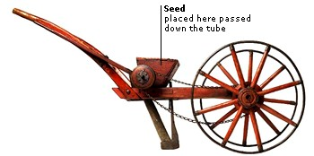
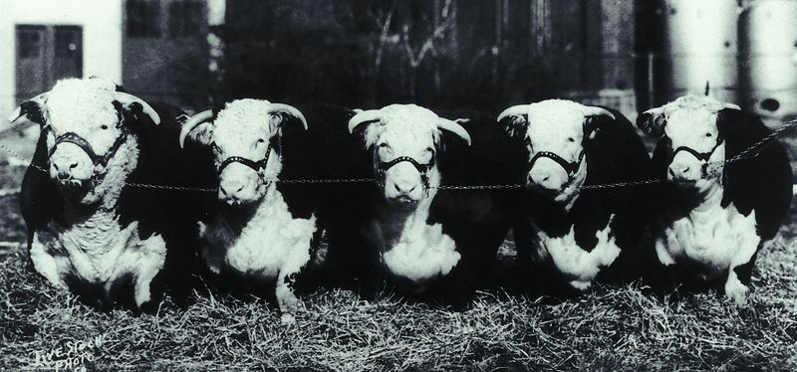
Agricultural Revolution
2^{nd – 15th and 18th century}
Innovation and Change
Machinery (seed drill)
Selective Breeding
Farmers can select the best individuals to breed from in order to produce the biggest, healthiest offspring
Enclosure Movement
Open fields divided up; hedges and fences
No more common land

Slide 11
Crops – what changed?
Many farmers sought to improve their crop yields. To do this, they improved the soil by muck spreading, adding lime or planting crops which put nitrogen back into the ground.
Fodder crops, such as turnips and clover, were grown. These helped restore the soil’s fertility, so there was no longer any need to leave the land fallow.
Year 1
Year 2
Wheat
Turnips
These new crops could be fed to livestock, allowing animals to be kept over the winter, rather than being slaughtered in the autumn.
Clover
Barley
Year 3
Year 4

Slide 12
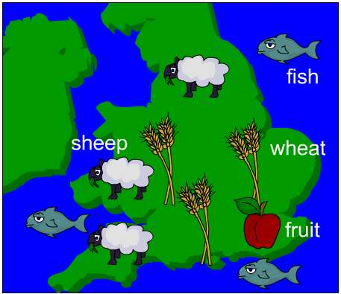
Specialization
Before 1750, most people were subsistence farmers. This means that they produced only what they needed to survive. Across Britain, families each grew a little corn, some root vegetables and kept a few animals.
Enclosure allowed farmers to specialize in the crops or animals best suited to their local climate, soil and terrain.
For example, the flat fertile land in East Anglia was ideal for wheat; fruit trees flourished best in Kent, while the hills of Wales were great for sheep farming.
Farming was far more productive if the conditions were ideal.

Slide 13
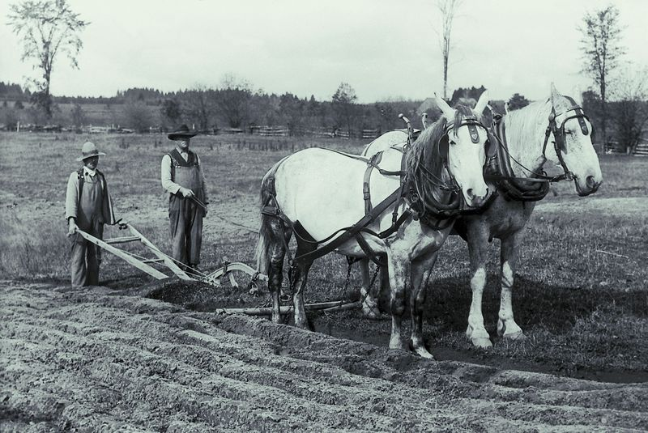
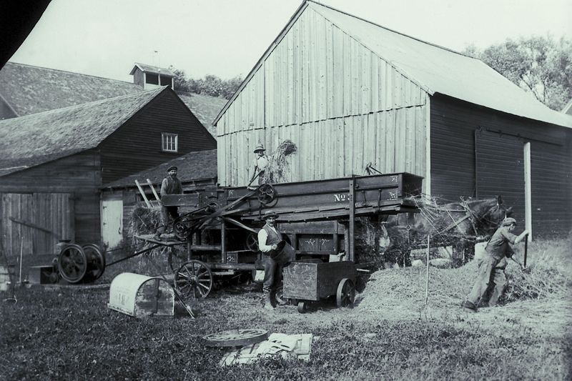
New machinery
Before 1750, farming was done by hand, with horses pulling ploughs and carts.
With the growth of the iron industry, new, heavy duty tools could be mass produced.
New machines were invented for activities such as threshing corn.
Notes:
Photos © 2007 Jupiterimages Corporation

Slide 14
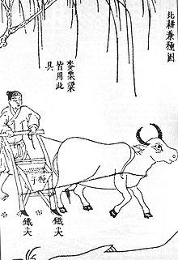
Note: Many of these practices were used in other places in the world prior to European use (not that we are Eurocentric or anything)
Seed drill, China 1637

Slide 15
Green Revolution
3rd Agricultural Revolution ----19th Century
Increased yields = more food
Land reforms, loans, distribution systems
Biotechnology = new, “improved” varieties of grains
Hybrid seeds; fertilizers, herbicides and pesticides
“Better” Techniques
Irrigation
Mechanization
Electric pumps, transportation

Slide 16
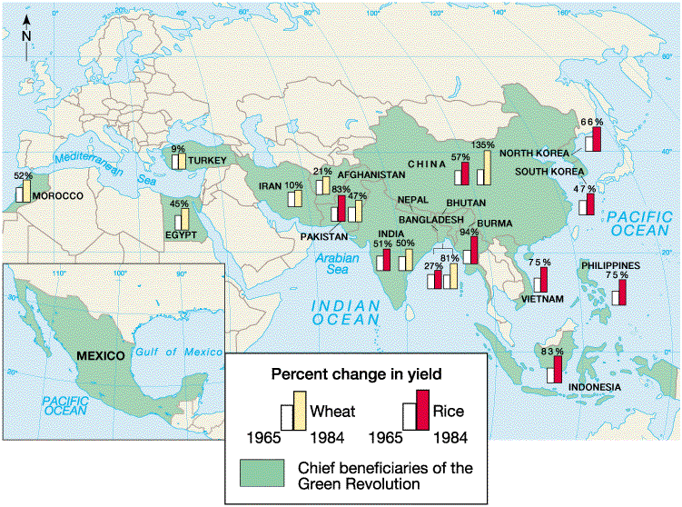

Slide 17
Green Revolution
Positives | Negatives
Grain production increased 45% | Higher yield crops more susceptible to viruses and bugs
Asian increase in rice by 66% | Environmental problems (pollution and soil contamination) more common; water resources strained
India became self-sufficient with rice by 1980s | Reduced number of workers needed on farms
Decreased famine | Farmers in periphery cannot afford technology

