Slide 1
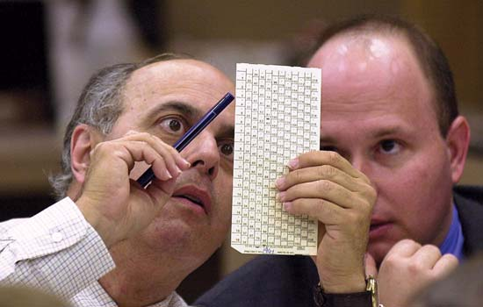
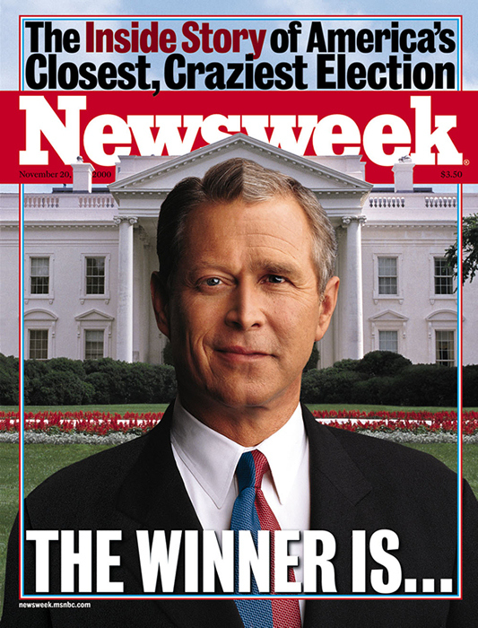
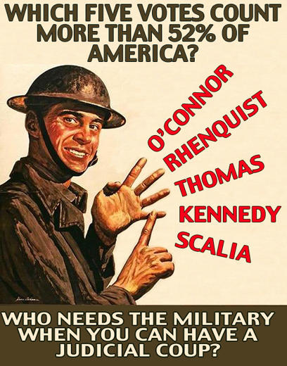
2000 Election

Slide 2
2000 Election Overview
Republican George W. Bush vs. Democrat Al Gore.
Initial returns: Gore had won the popular vote, but neither candidate had garnered the 270 electoral votes required to win the presidency.
The election hinged on results from the state of Florida, where the vote was so close as to mandate a recount.
The outcome of the election was ultimately decided by the US Supreme Court in Bush v. Gore. The court, in a 5-4 vote along partisan lines, ruled in favor of Bush.

Slide 3
2000 presidential campaign
Republican George W. Bush, governor of Texas and son of former US president George H.W. Bush,
Democrat Al Gore, former senator from Tennessee and vice president in the administration of Bill Clinton.
Because Clinton had been such a popular president, Gore had no difficulty securing the Democratic nomination, though he sought to distance himself from the Monica Lewinsky scandal and Clinton’s impeachment trial.
Bush won the Republican nomination after a heated battle against Arizona Senator John McCain in the primaries. He chose former Secretary of Defense Dick Cheney as his running mate.
In their presidential campaigns, both candidates focused primarily on domestic issues, such as economic growth, the federal budget surplus, health care, tax relief, and reform of social insurance and welfare programs, particularly Social Security and Medicare.

Slide 4
Results of the 2000 election
On election day, Gore won the popular vote by over half a million votes.
Bush carried most states in the South, the rural Midwest, and the Rocky Mountain region.
Gore won most states in the Northeast, the upper Midwest, and the Pacific Coast.
Gore garnered 255 electoral votes to Bush’s 246, but neither candidate won the 270 electoral votes necessary for victory.
Election results in some states, including New Mexico and Oregon, were too close to call, but it was Florida, with its 25 electoral votes, on which the outcome of the election hinged.

Slide 5
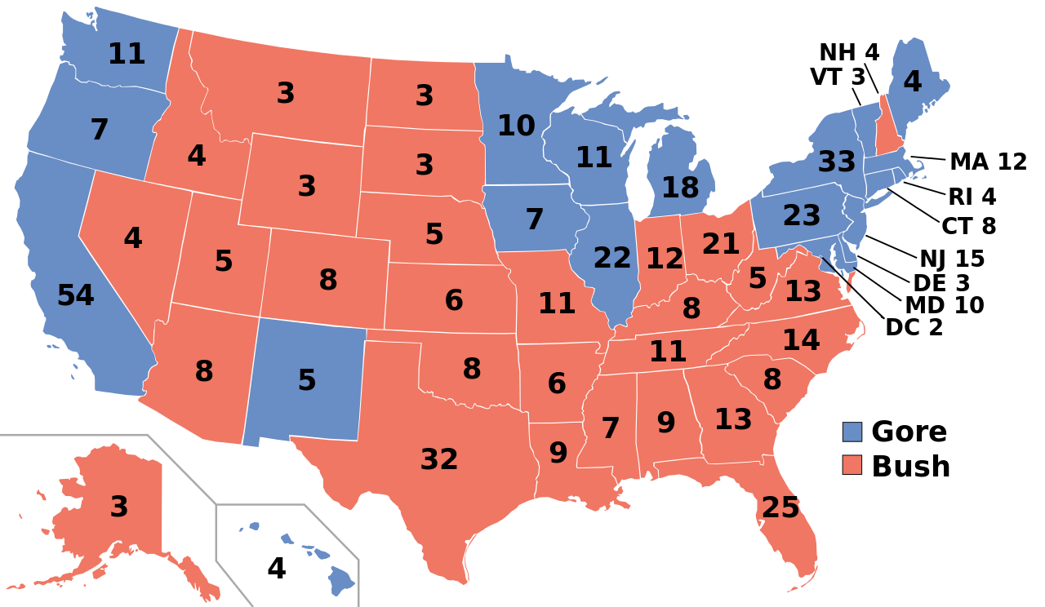
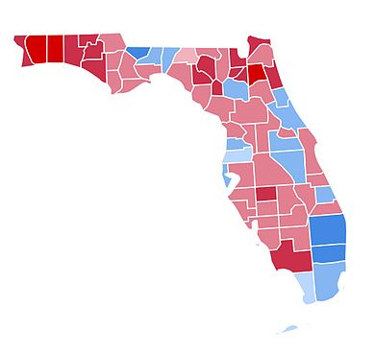

Slide 6
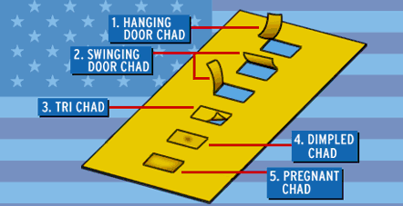
Based on exit polls in Florida, the news media declared Gore the winner, but as the actual votes were tallied, Bush appeared to command the lead. When 85 percent of the vote had been counted, news networks declared Bush the winner, though election results in a few heavily Democratic counties had yet to be tallied.
Disputes erupted over the accuracy and reliability of election technology in the state, with confusion over “butterfly ballots” (ballots that have names on both sides), punch card voting machines, and “hanging chads” (punch card ballots that were only partially punched). These convoluted ballot designs led to calls for election and voting reform, and some states installed electronic voting machines to ensure greater accuracy in future elections.
The result in Florida was so close as to trigger a statewide mandatory machine recount according to the Florida Election Code. The Gore campaign then requested that the disputed ballots in four counties be recounted by hand. The Florida Supreme Court extended the deadline for the recount and ordered a manual recount. The Bush campaign appealed the decision, and the US Supreme Court agreed to hear the case.

Slide 7
Bush v. Gore
In the resulting case, Bush v. Gore, the US Supreme Court ordered that the recount be stopped. The incomplete recount was halted, and Bush was awarded Florida’s electoral votes and declared the president-elect.
The 5-4 vote was along partisan lines, meaning the justices appointed by Republican presidents ruled in favor of Bush and the justices appointed by Democratic presidents argued in favor of Gore.
George W. Bush’s brother, Jeb Bush, was the governor of Florida at the time of the recount, although no evidence of wrongdoing surfaced. Al Gore conceded the election to Bush, but disagreed with the US Supreme Court’s ruling.
The 2000 presidential election was the closest in the history of the US Electoral College and the first ever to be decided by the US Supreme Court.
George W. Bush entered office as an embattled president, with many questioning his legitimacy.

Slide 8
What do you think?
How does the election of 2000 compare to other presidential elections?
Do you think the Supreme Court was right to halt the recount in Florida? Why or why not?
What were the long-term consequences of the 2000 election?

